Slide 1
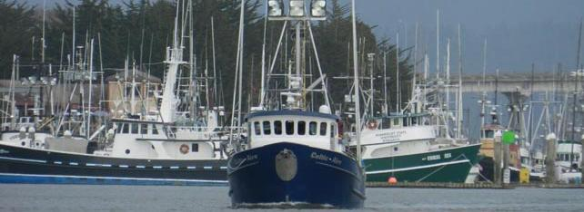
Humboldt Bay Harbor, Recreation, & Conservation District
Larry Oetker, Executive Director

Slide 2
January 18th Storm
  20 foot waves
  Coast Guard closed port
  Bell Bouy # 2 off South Jetty drifted 400 feet north creating hazard
  Bouy Tended Aspen will need to retrieve and re anchor
January 23 Kodiak Alaska Earthquake/ Tsunami Warning
  7.9 earthquake
  3:00 am Harbor District Staff called up, mobilized equipment and established remote command center out of tsunami zone.
  4:00 am Tsunami watch lifted and Staff shifted from emergency response to emergency drill
January 25th Water spout confirmed hit directly through Woodley Island Marina

Slide 3
Commercial Crabbing Season
  $2.75 agreed price
  Fisherman will set pots any day
District Finances
  Audit approved 1-25-18
  No Findings or Issues of Concern
  Operating revenues increased $458,000
  Expenses decreased $6,000

Slide 4
Dredging Bay Entrance
  ACOE funded and scheduled
    600,000 cubic yards from Federal Channel
    Start Date June 20, 2018
    # 3 of 8 ports dredged
Woodley Island
  Began permit application process for clam shell with HOODS disposal.
  Analyzing sounding data to:
    Estimate cubic yards
    Determine critical dredging areas
    Develop dredging strategy/ cost estimates

Slide 5
Dredging Disposal Options
  Beach disposal currently not allowed by USEPA
  District owns and has CDP for Samoa Lagoons.
    Water Board determined:
      If infiltration dewatering: salt water from dredge materials must meet groundwater drinking water objectives
      If surface runoff to bay: 7 acre site must be lined
  Upland disposal highly unlikely this season
  HOODS offshore site
    Eureka Small Boat basin permitted:
      10 year maintenance dredging
      100,000 cy annually 1 million over 10 years
    ACOE
      Federal Channel
      2018 up to 2 million cy

Slide 6

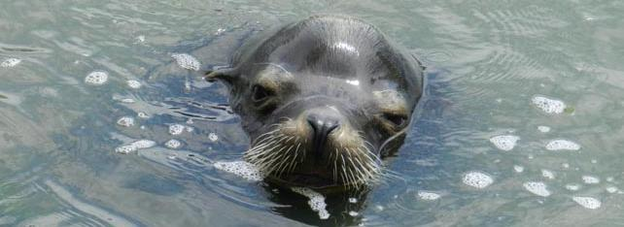
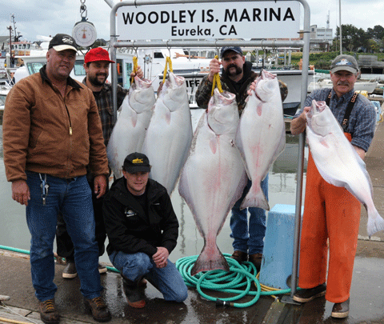
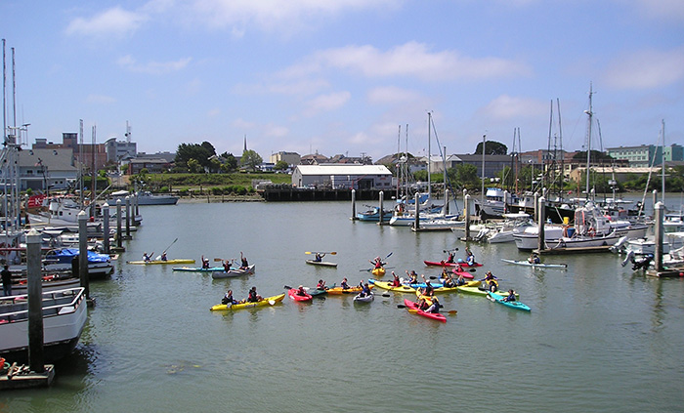
Recreation,& Conservation
Photo from myfishingbuddy.com

Slide 7
Harbor
Pilotage
Shoreline Protection
Dredging
Development Permits
Port Marketing
Aquaculture
Commercial Fishing Facilities
Oil Spill Coordination

Slide 8
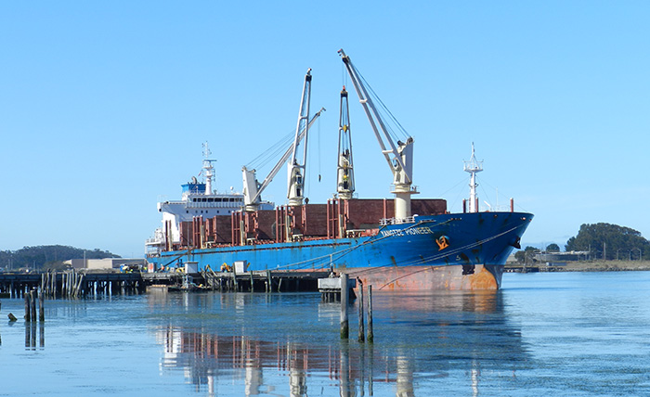

Slide 9
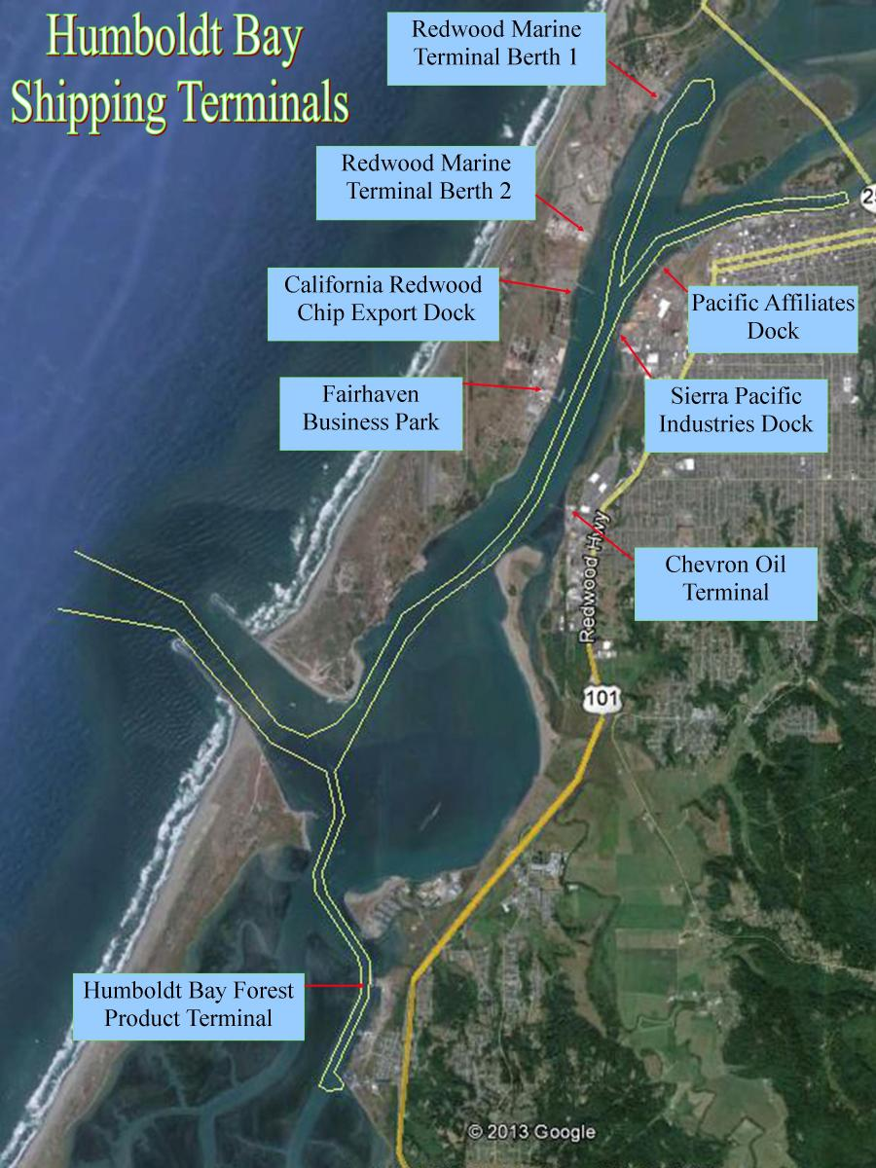
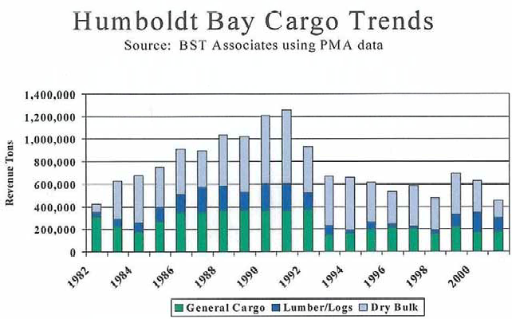
Cargo metric tons
2018 projected 632,000
2017 490,000
2016 539,000
Facilities shifting to smaller barges due to shallow draft restrictions
Sierra Pacific chip exports halted
  Rebuilding dock

Slide 10
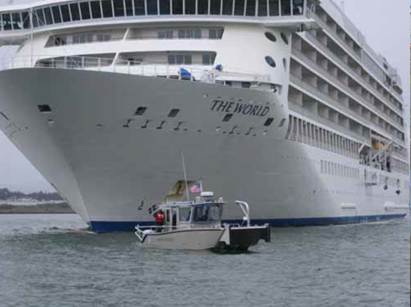
Cruise Ships
May 28, 2018 Silver Explorer
Capacity of 200 passengers
May 27, 2019 Maasdam
June 17, 2019 Maasdam
July 8, 2019 Maasdam
Sept 28, 2019 Volendam
Capacity of 1258 passengers

Slide 11
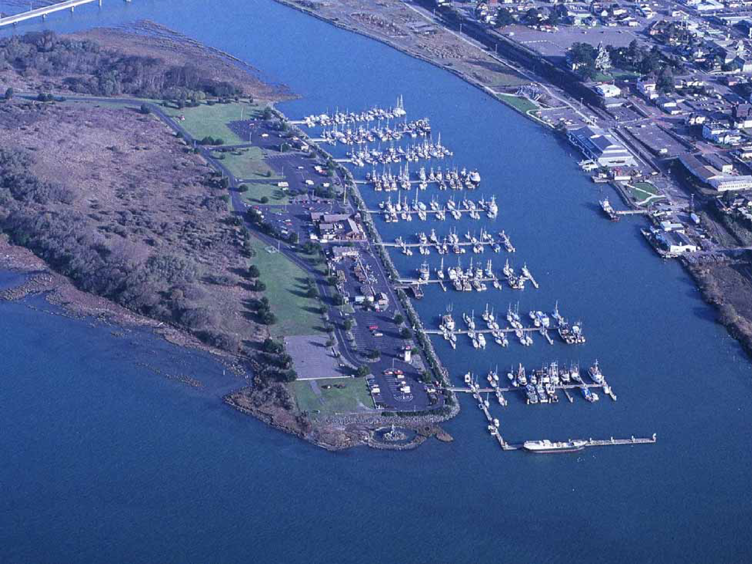
237 Slips
Fisherman’s Work Area Pilotage
Port Authority Fireboat
Port Authority Security Boat
Fork Lift
2 and 1 Ton Hoist

Slide 12
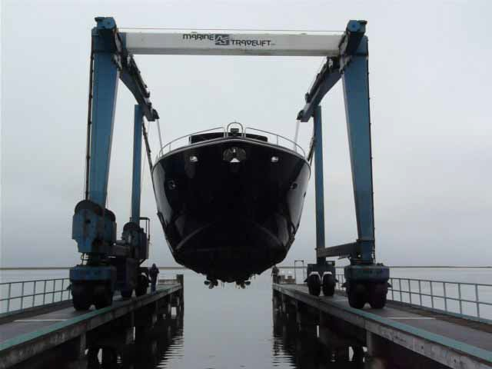
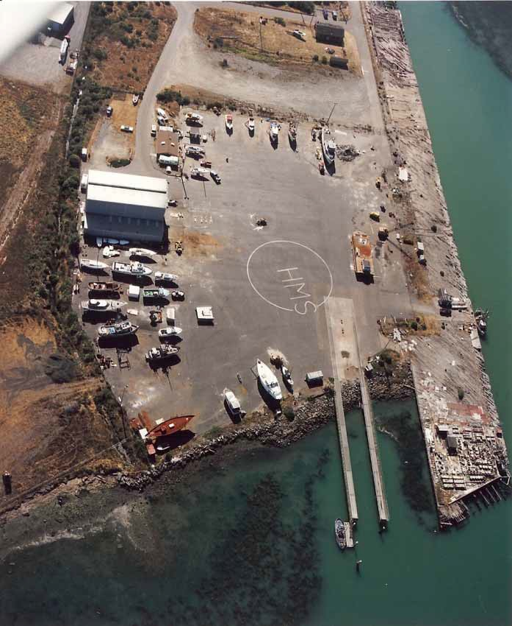
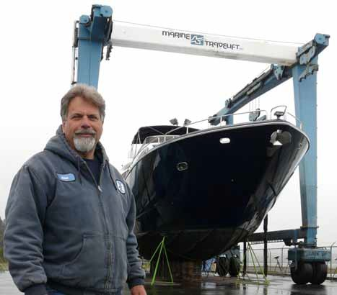
Fields Landing Boat Yard

Slide 13
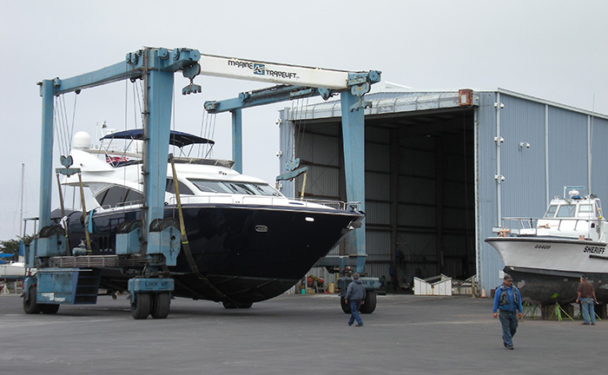
Fields Landing Boat Yard
lifts per year 200
Dead Boat Storage 18
Long term storage 6
Small boat storage 2
Currently being repaired 2
Reincke Marine Fabrication

Slide 15
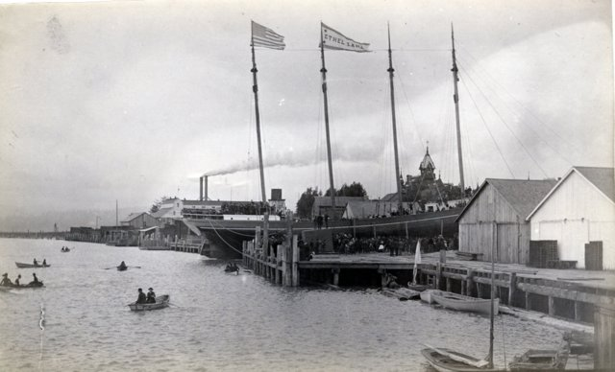
We know our past,
but what is our future?

Slide 16
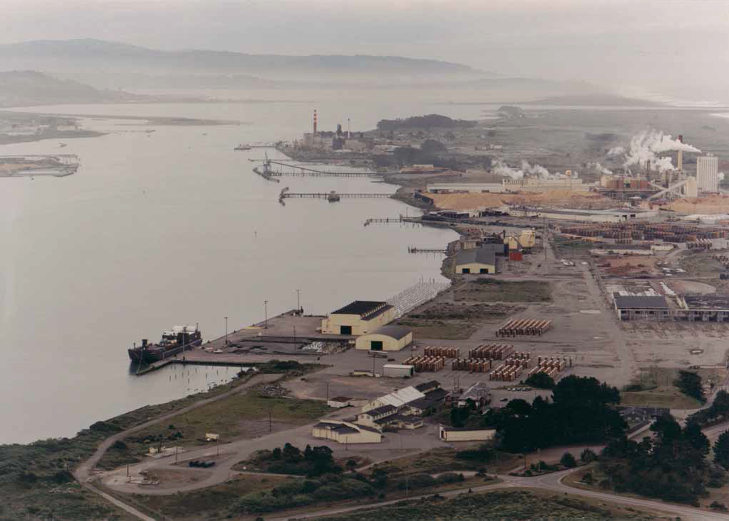
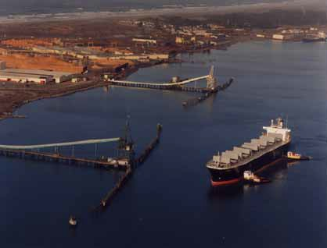
25 Years Ago
Simpson Pulp Mill
Louisiana Pacific Pulp Mill
Sierra Pacific Industries
North Coast Chip Export
Pacific Affiliates

Slide 17
Vance Avenue
is privately-owned
(Segments 3 & 4)

Slide 18
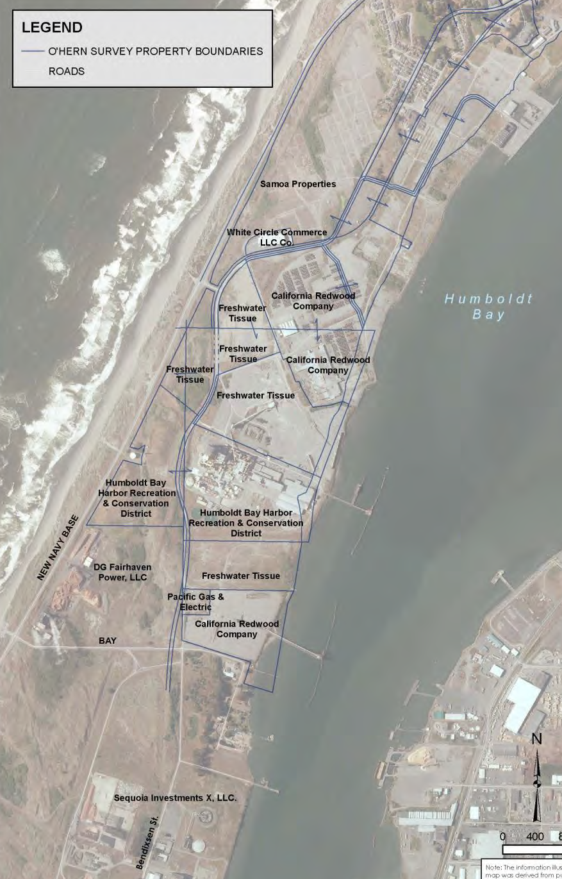
Current Ownership

Slide 19
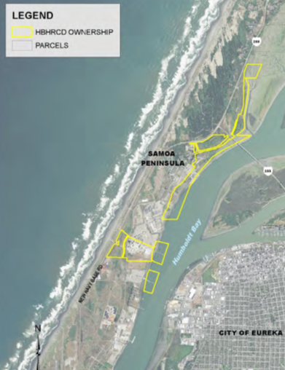

Slide 20
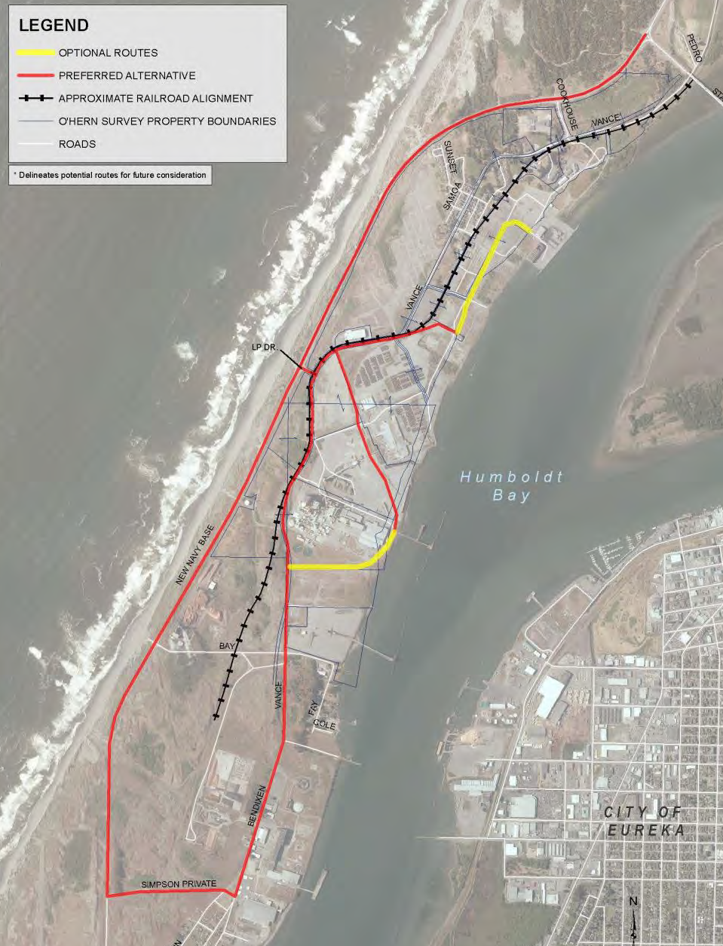

Slide 21
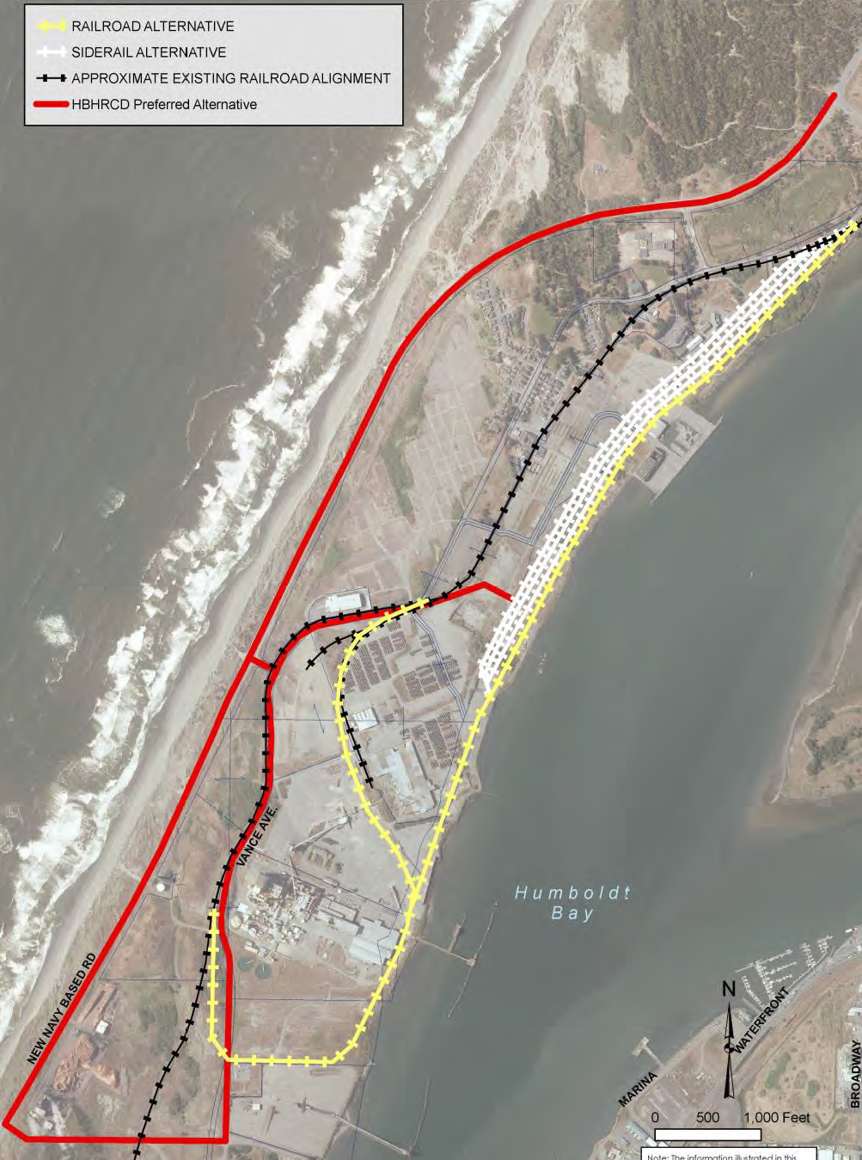

Slide 22
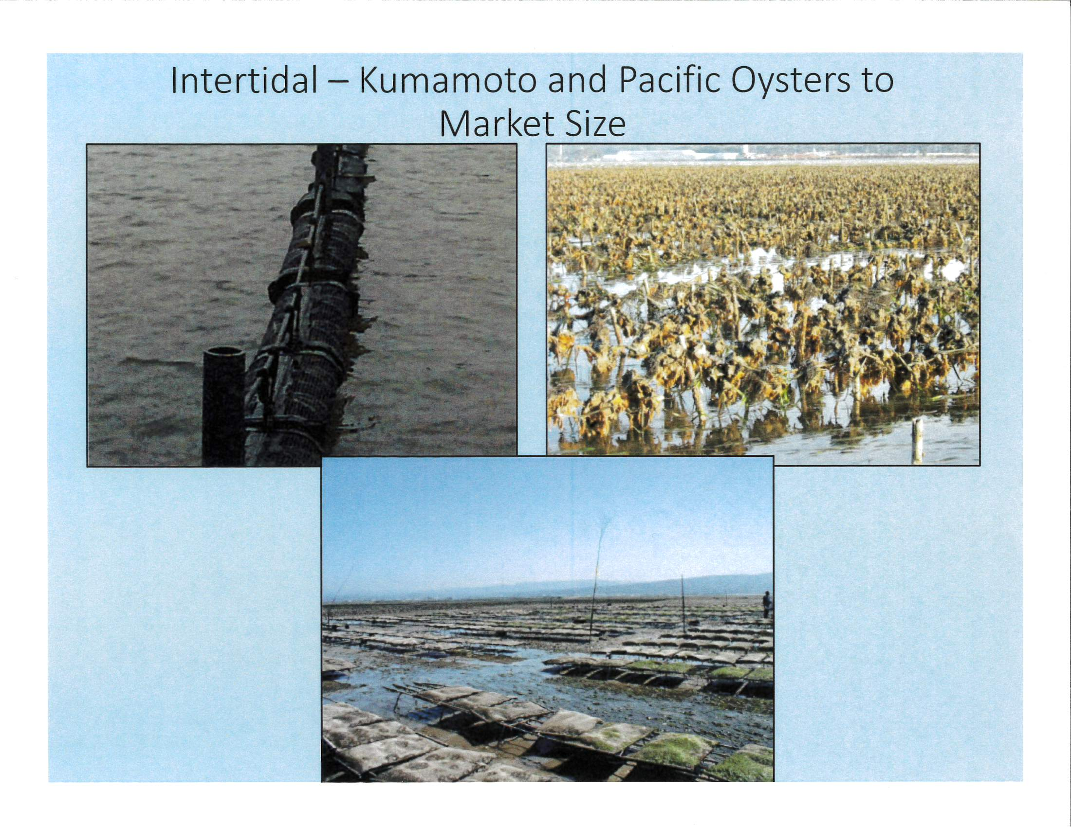

Slide 23
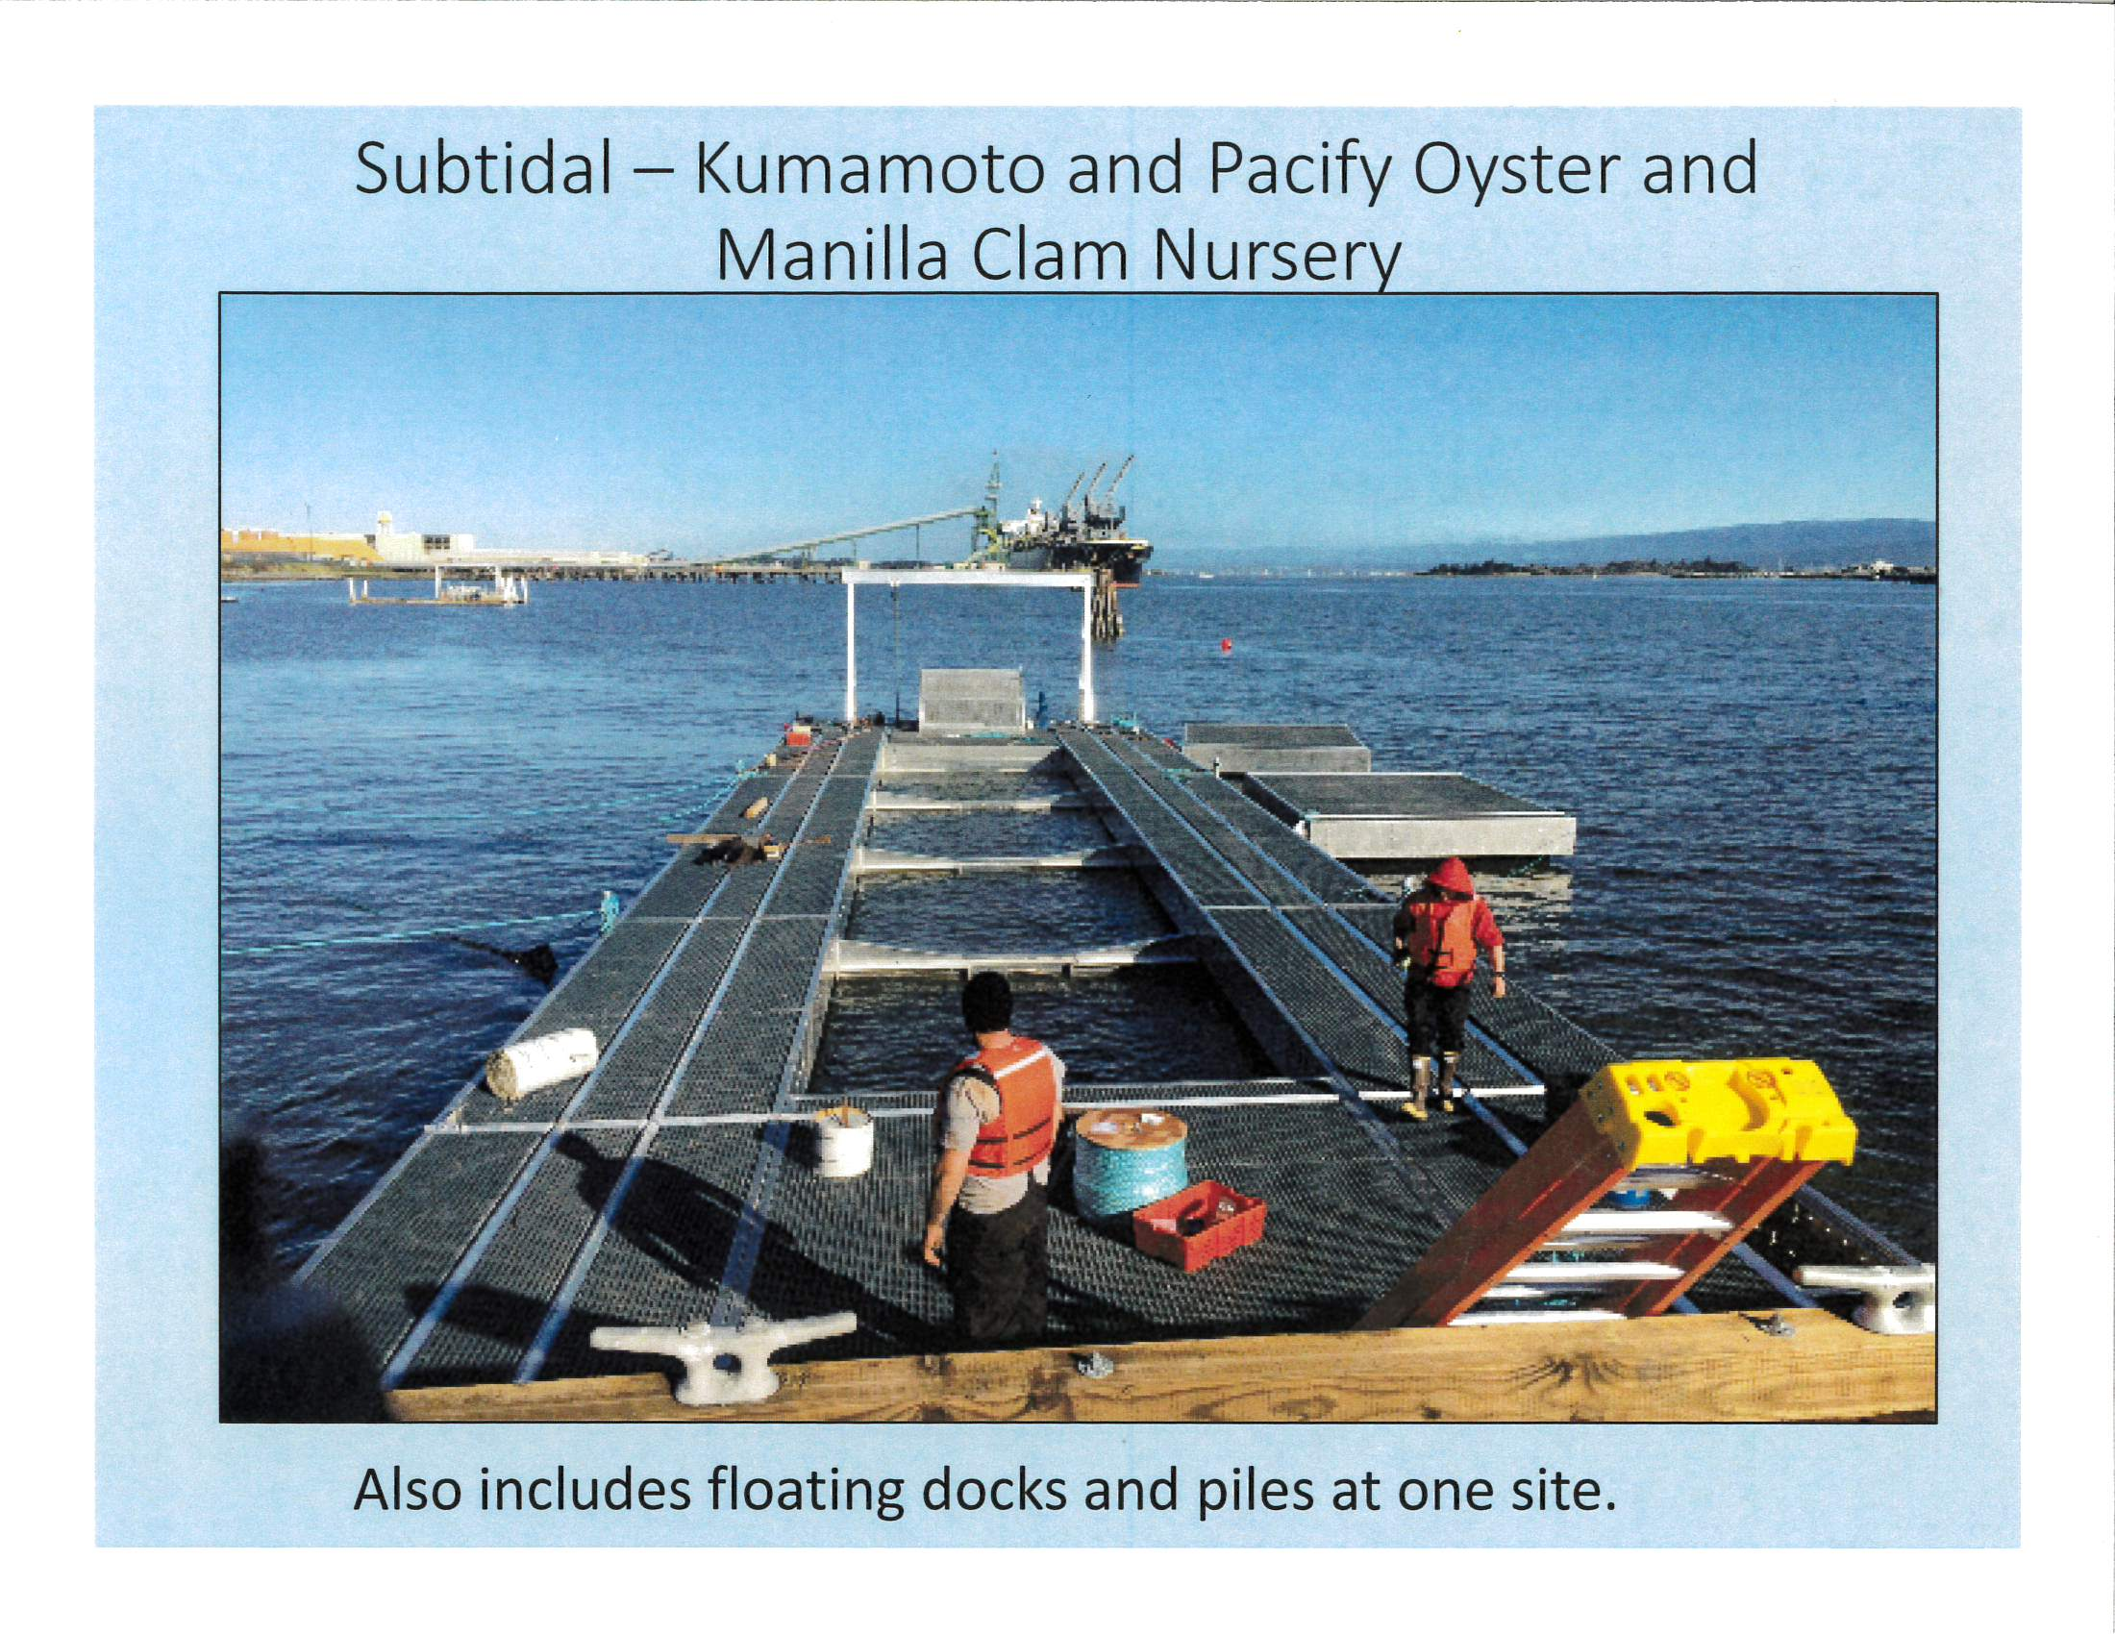
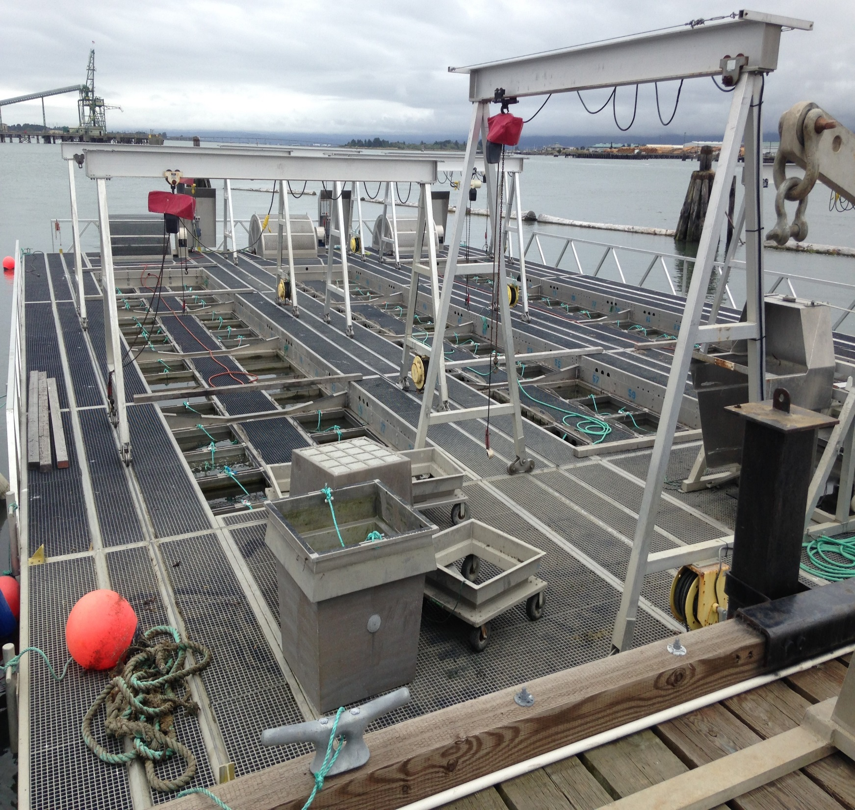

Slide 24
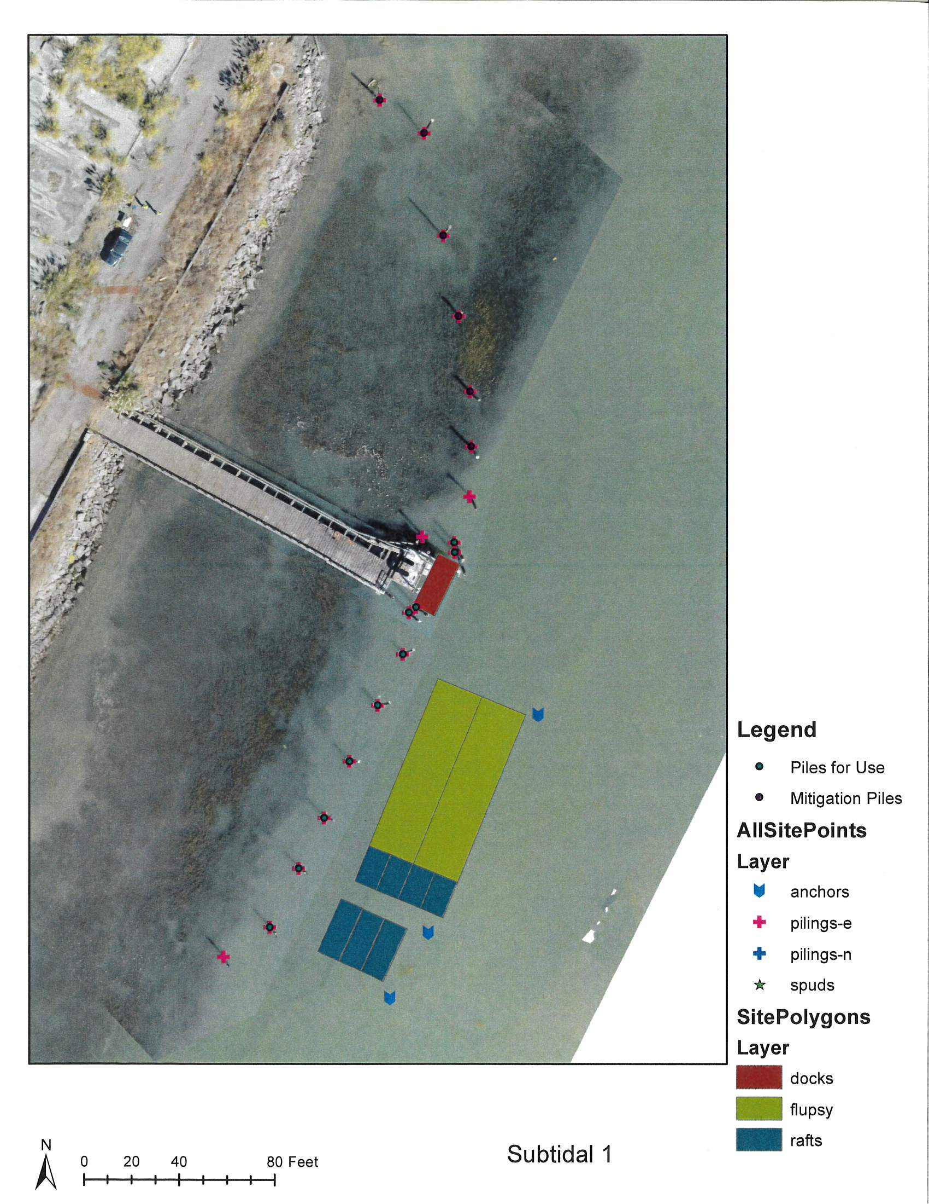

Slide 25
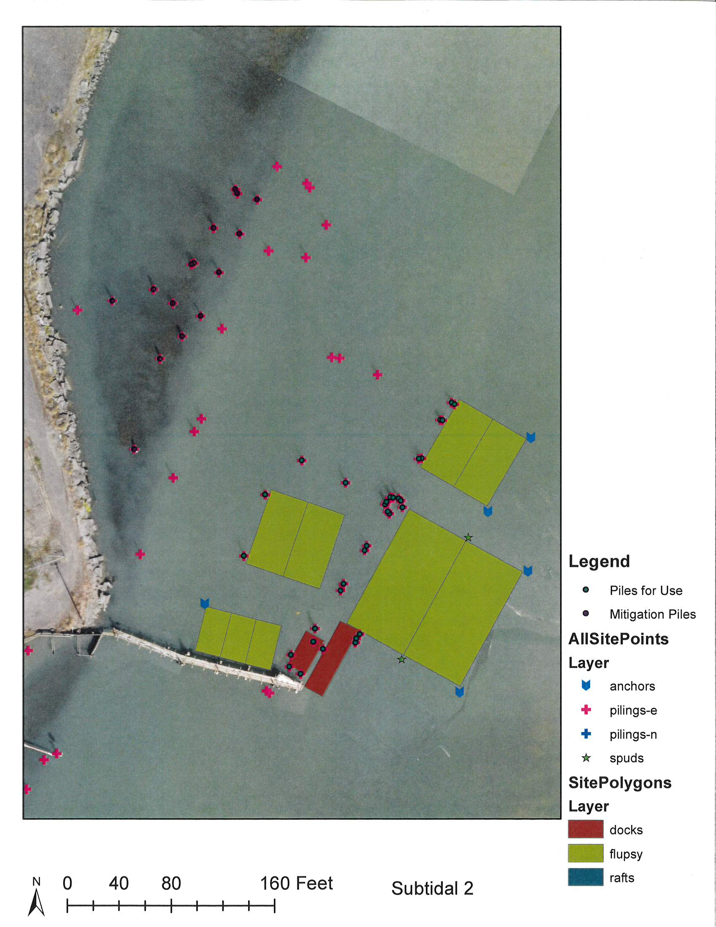

Slide 26
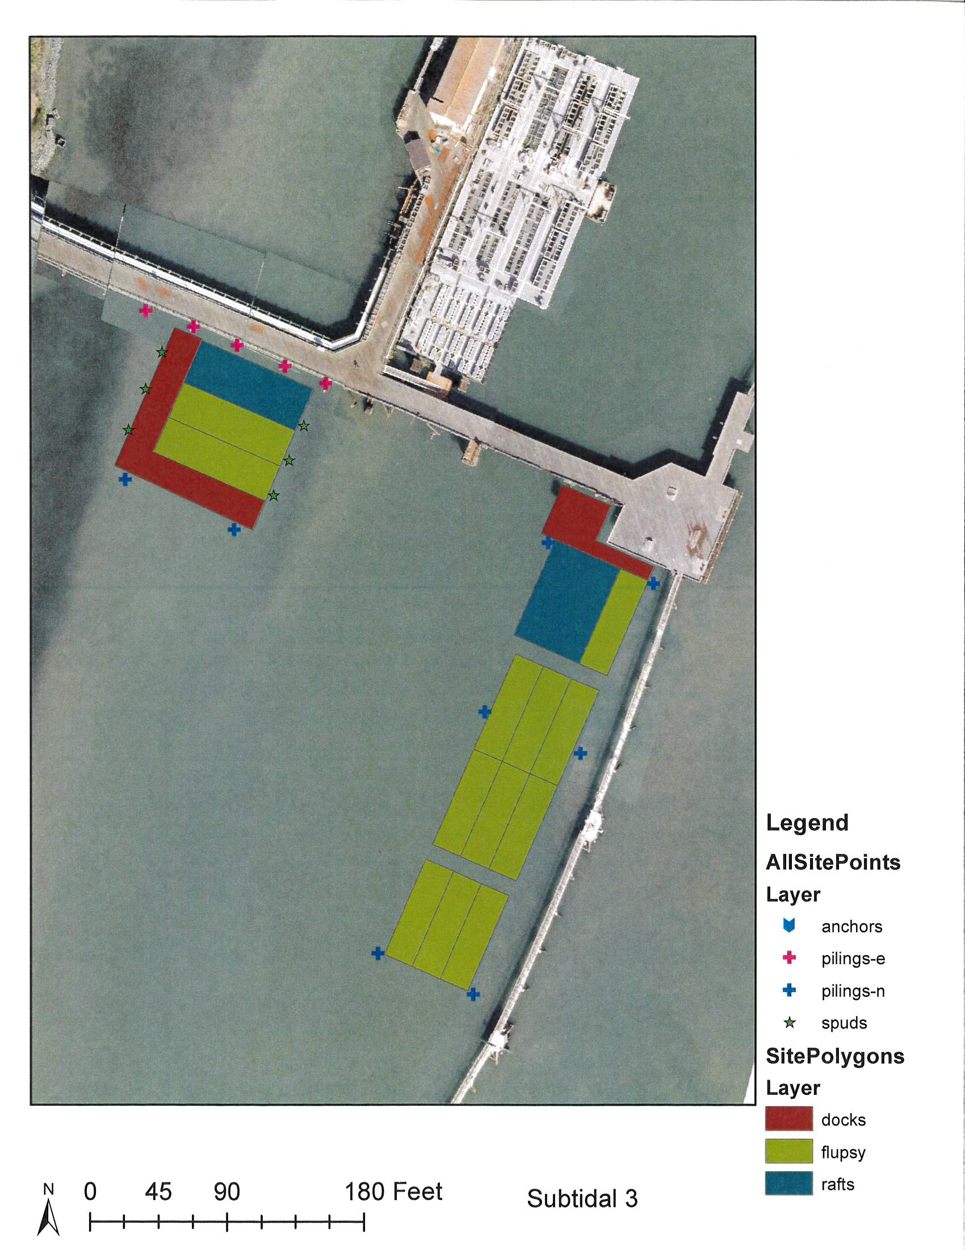

Slide 27
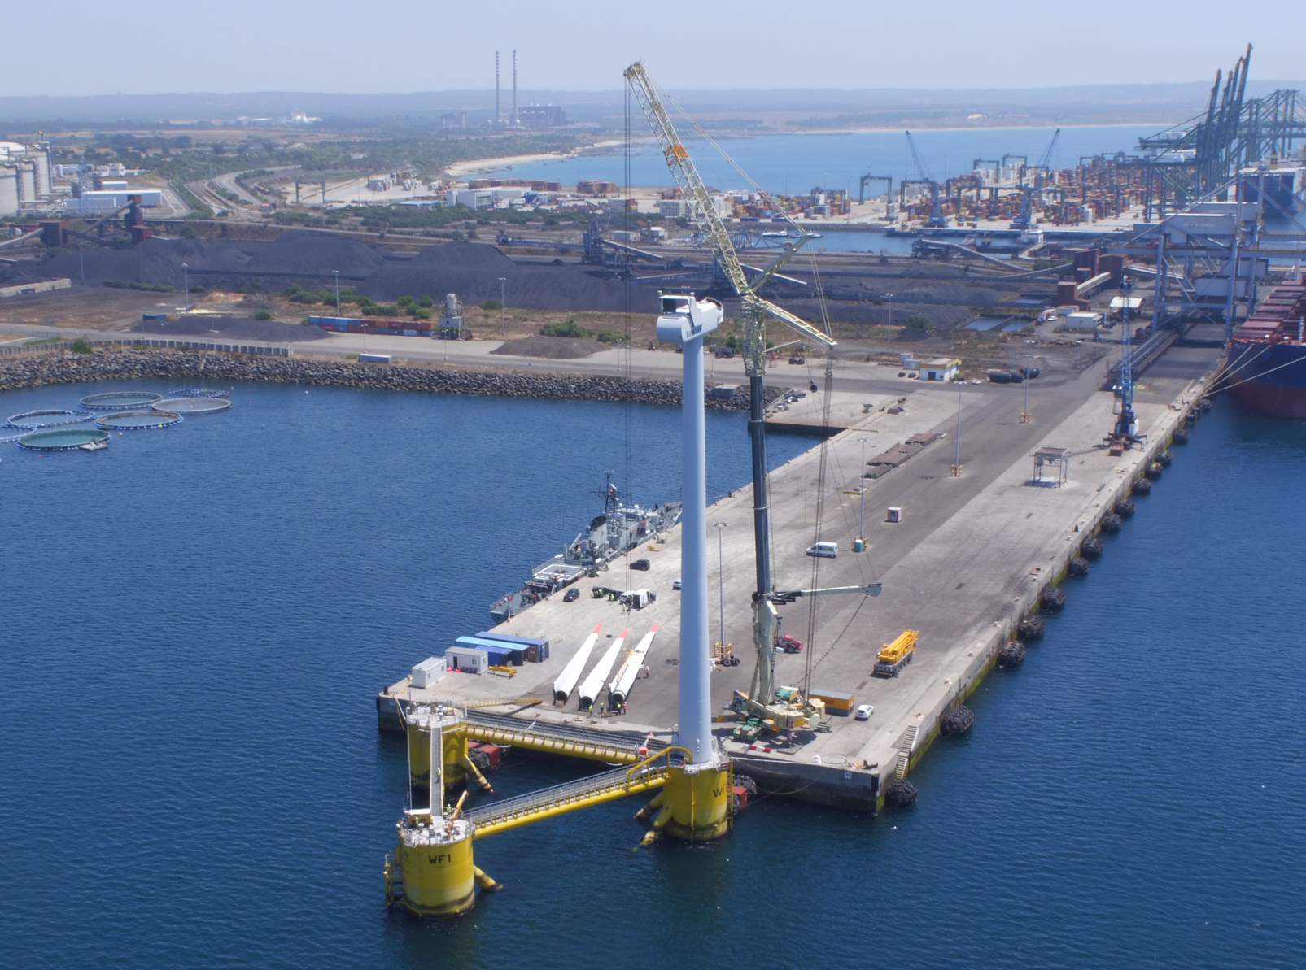
Upland (~50 acres)
Storage/Staging/Assembly line for hull and turbine components
  Infrastructure to load-out assembled hulls (slipway for instance)
Quayside requirements:
  Deep-draft facility (10m+ of water depth)
  Quayside length of at least ~250m and width of at least ~40-50m to offload components (based on cargo vessel)
  Bearing capacity to support WTG erection operation (lift of 500-600 tonnes at 100-120m – typically 30 tonnes/m2)
  Wet storage capabilities (for finished hulls)
Cranage to support assembly (Crawler cranes available in the area)

Slide 28
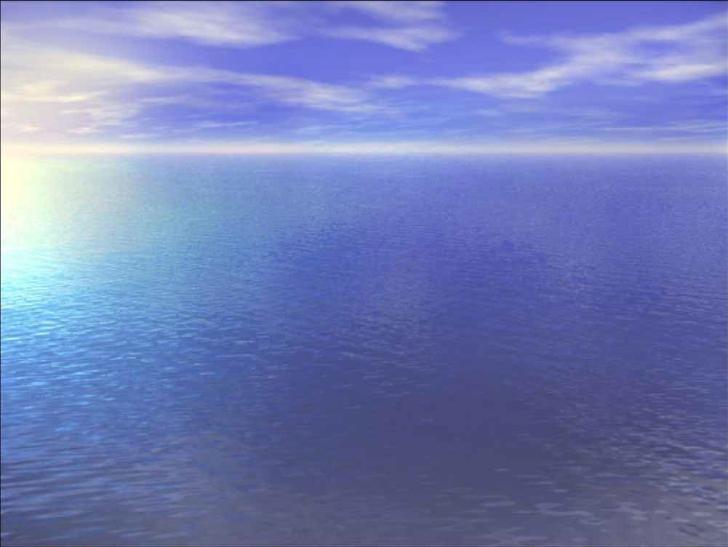
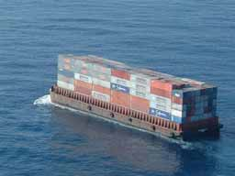
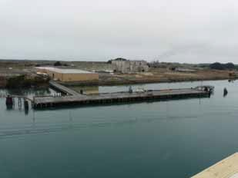
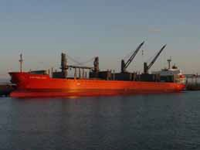
Stand-alone Multipurpose Berth
Minimum Requirements
Solid Multipurpose Cargo Dock
38’ Feet of Water alongside Pier to Channel
100 Acres upland Property for Cargo Staging
Two Access Points Preferred
Trained Labor Force/Crane Operators
Container on Barge
Cargo Dock
Local Bulk/Project Cargo

Slide 29
