Slide 1
Timber Heritage Association 2016

Slide 2
Sense of Place
a. A characteristic of a place itself that is memorable or distinctive, thus particular cities, symbolic, or sacred locations like New York, Stonehenge, or Jerusalem may be said to have a strong sense of place, a uniquely significant meaning for large numbers of people. Such places may be culturally specific.
b. The consciousness that people themselves have of places that possess a particular significance to them, either personal or shared. Places where significant events have occurred may also elict a strong sense of place.

Slide 3
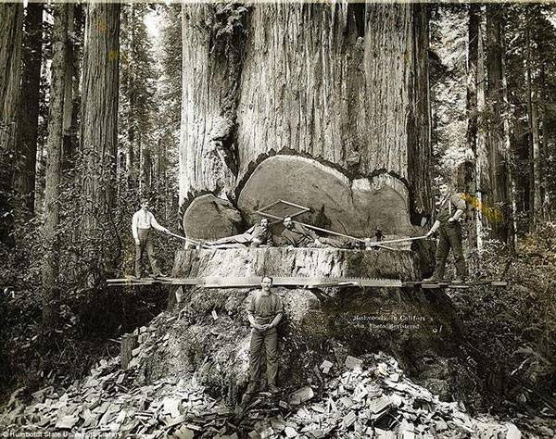
Giant Redwoods as a Sense of Place

Slide 4
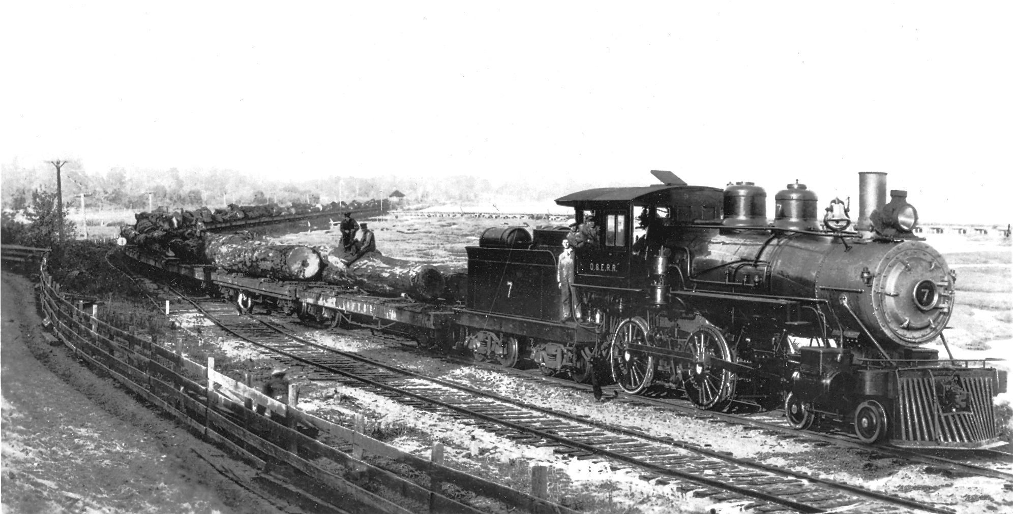
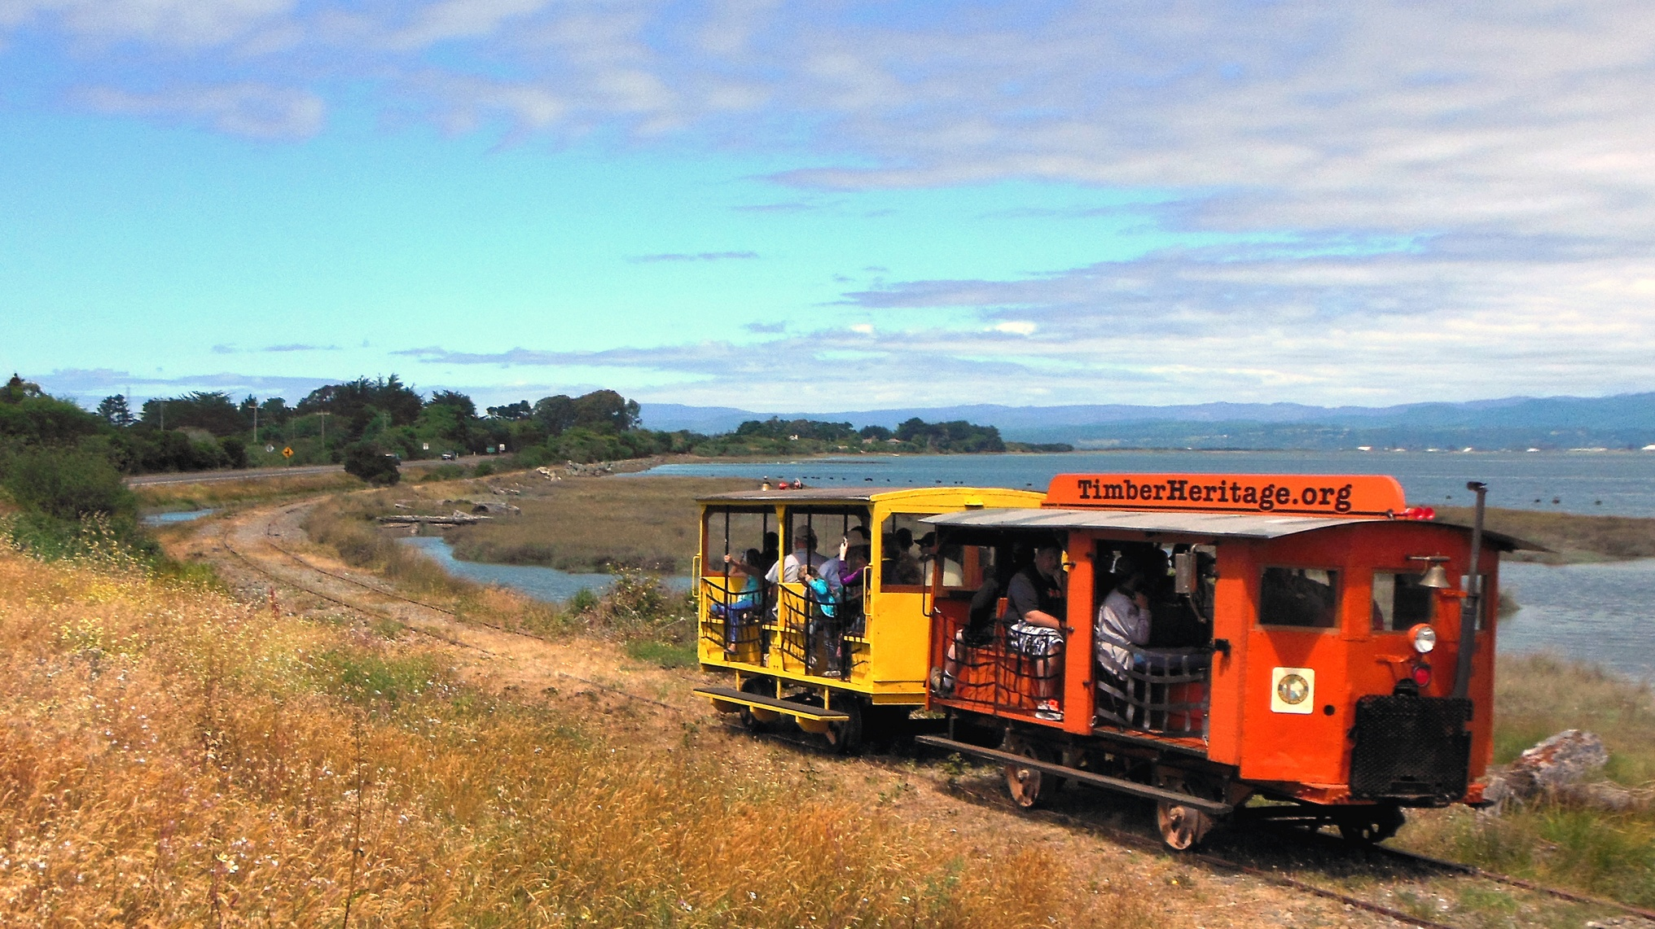
Bridging the Gap from Old to New

Slide 5
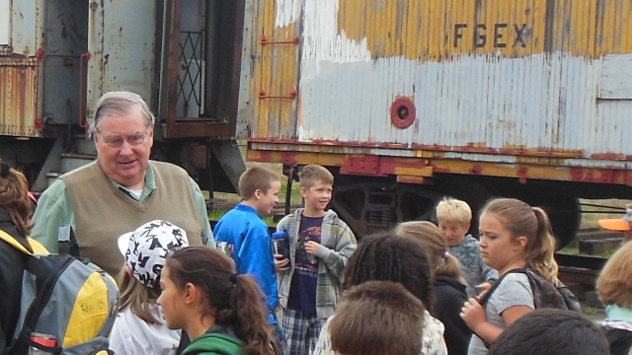
Educational Tours Maintain the Sense of Place

Slide 6
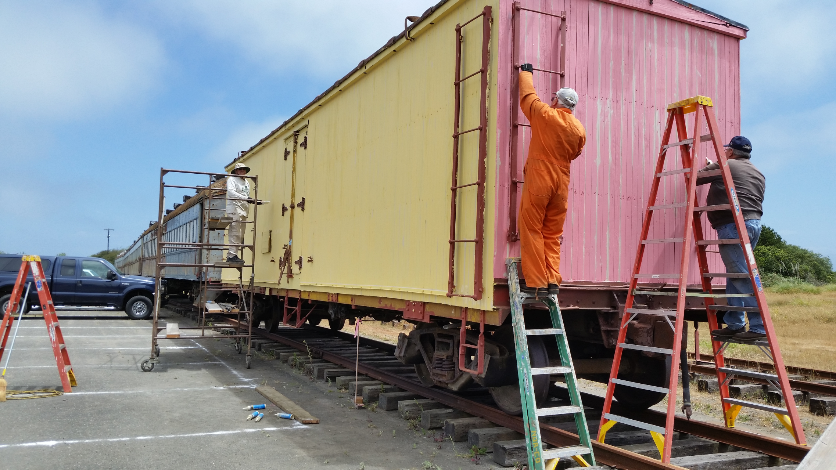
It is a Lot of Work to Prepare for the Future

Slide 7
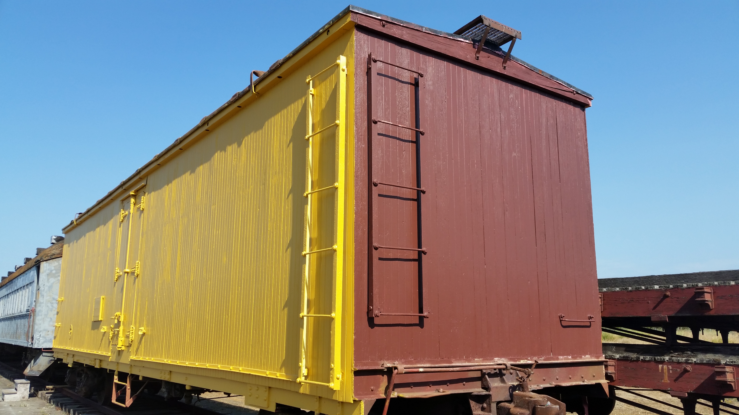
But the Finished Product is Worth it!

Slide 8
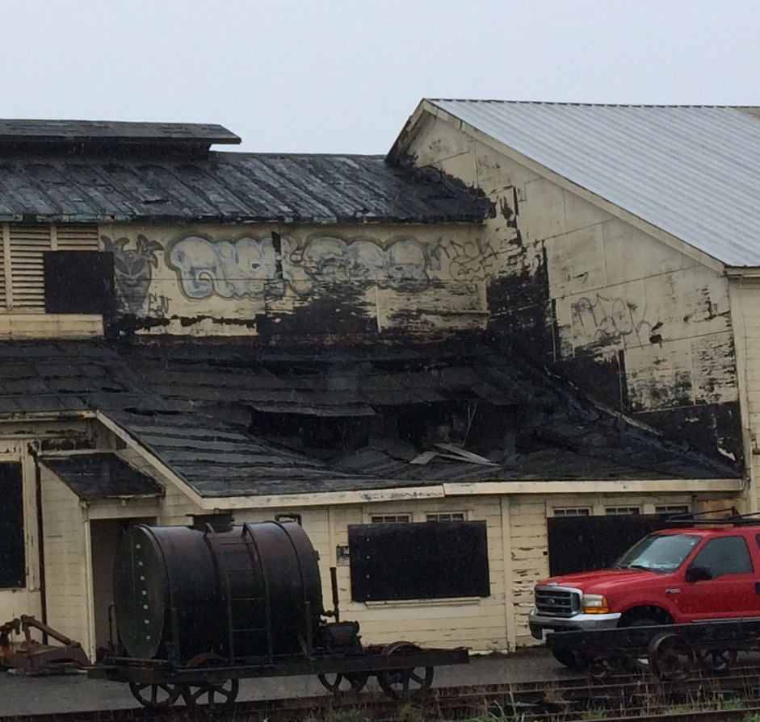
Old Roof on Blacksmith Shop

Slide 9
New Roof on Blacksmith Shop

Slide 10
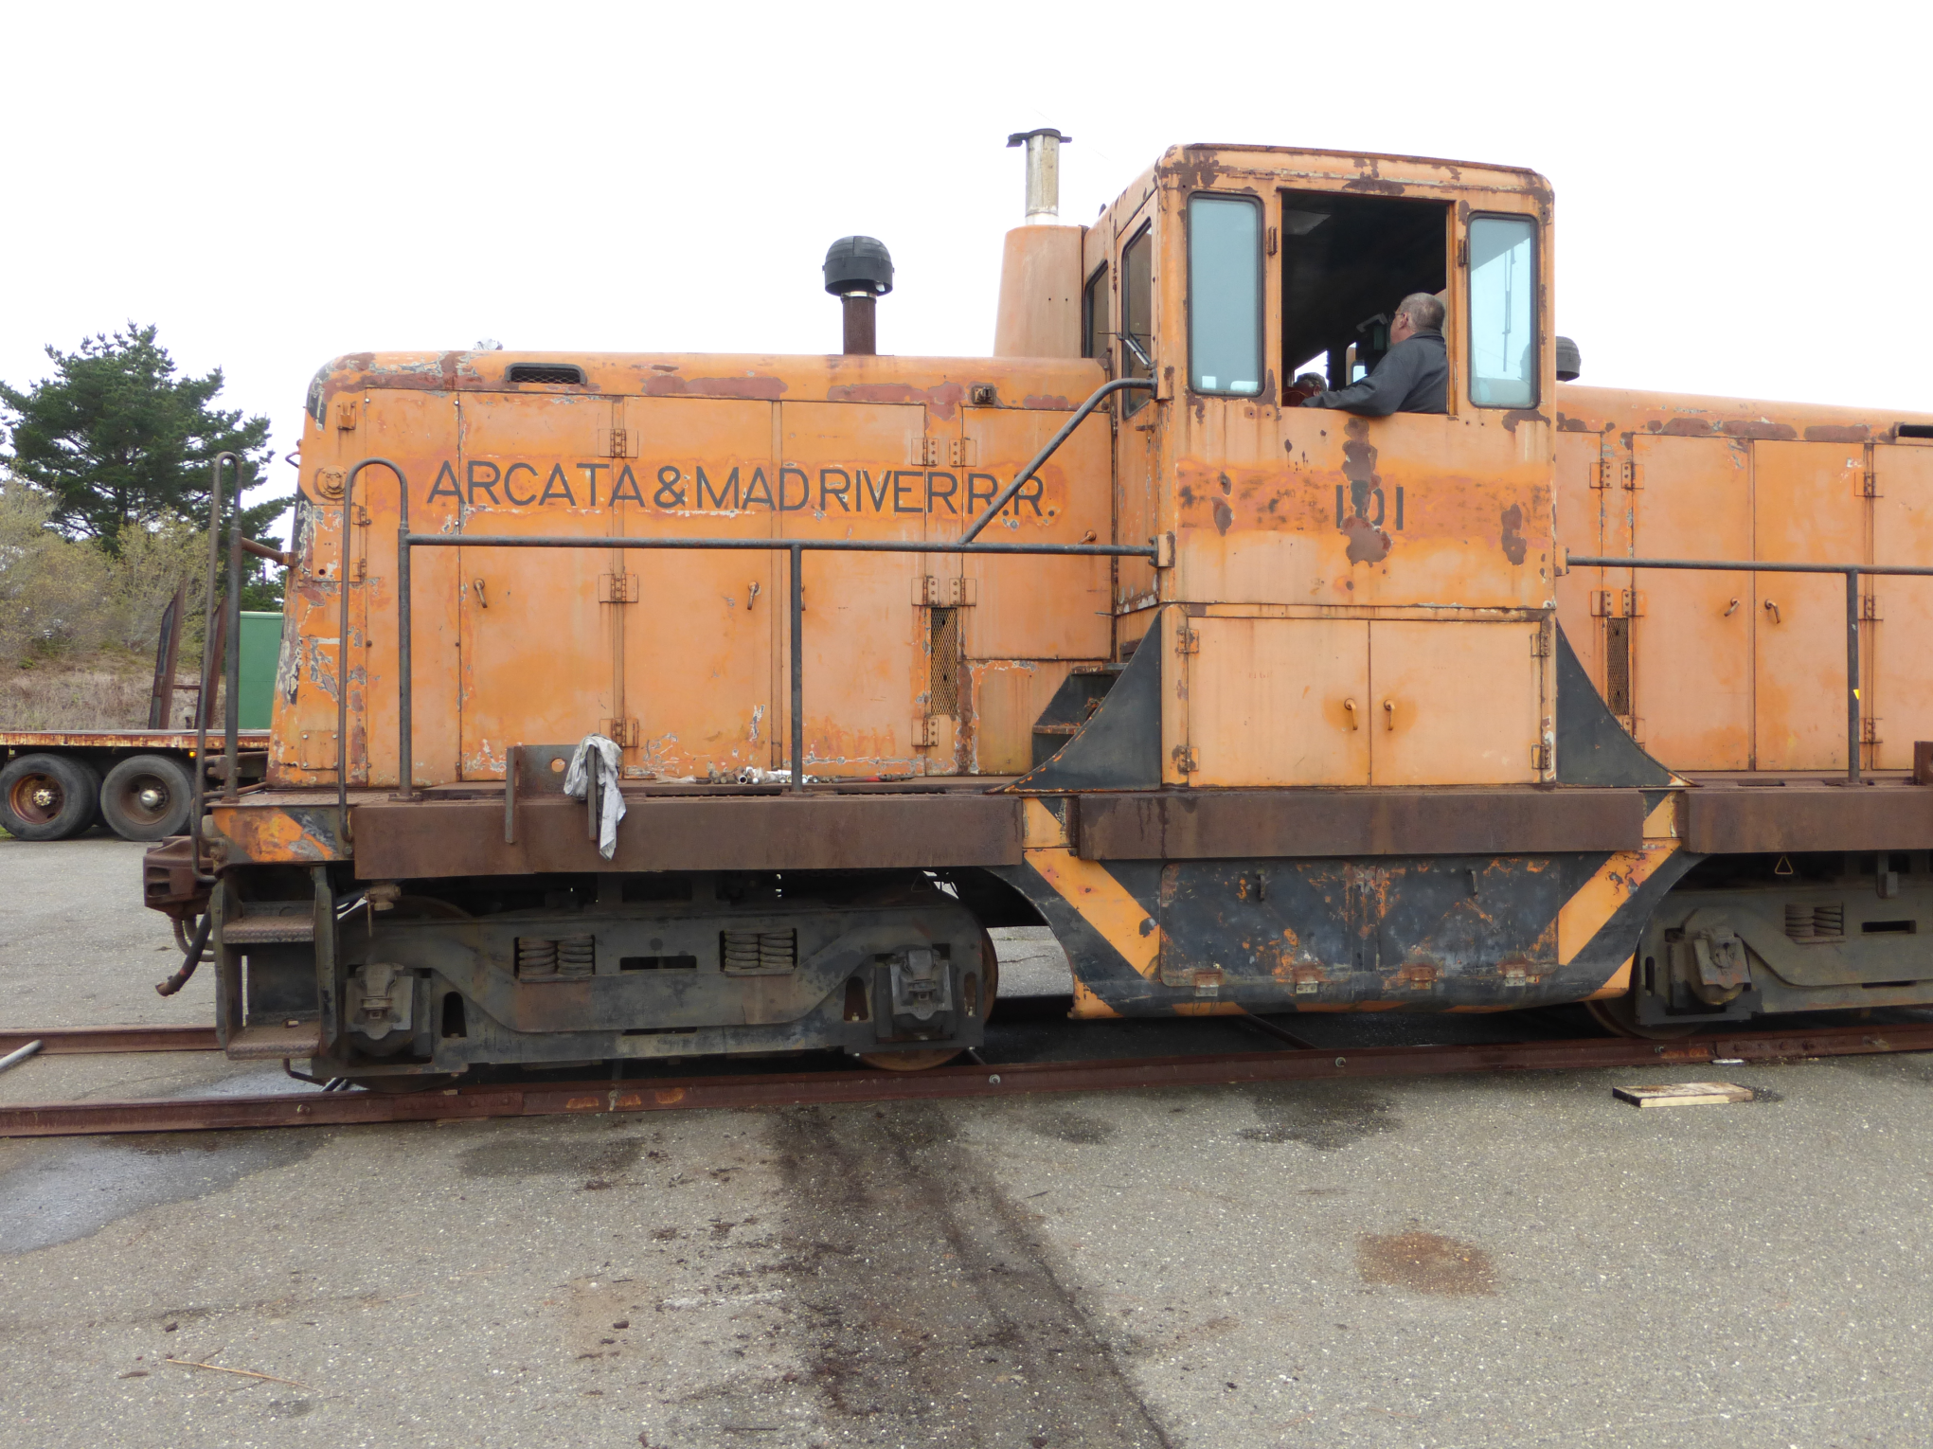
Even the Equipment Needs Upkeep

Slide 11
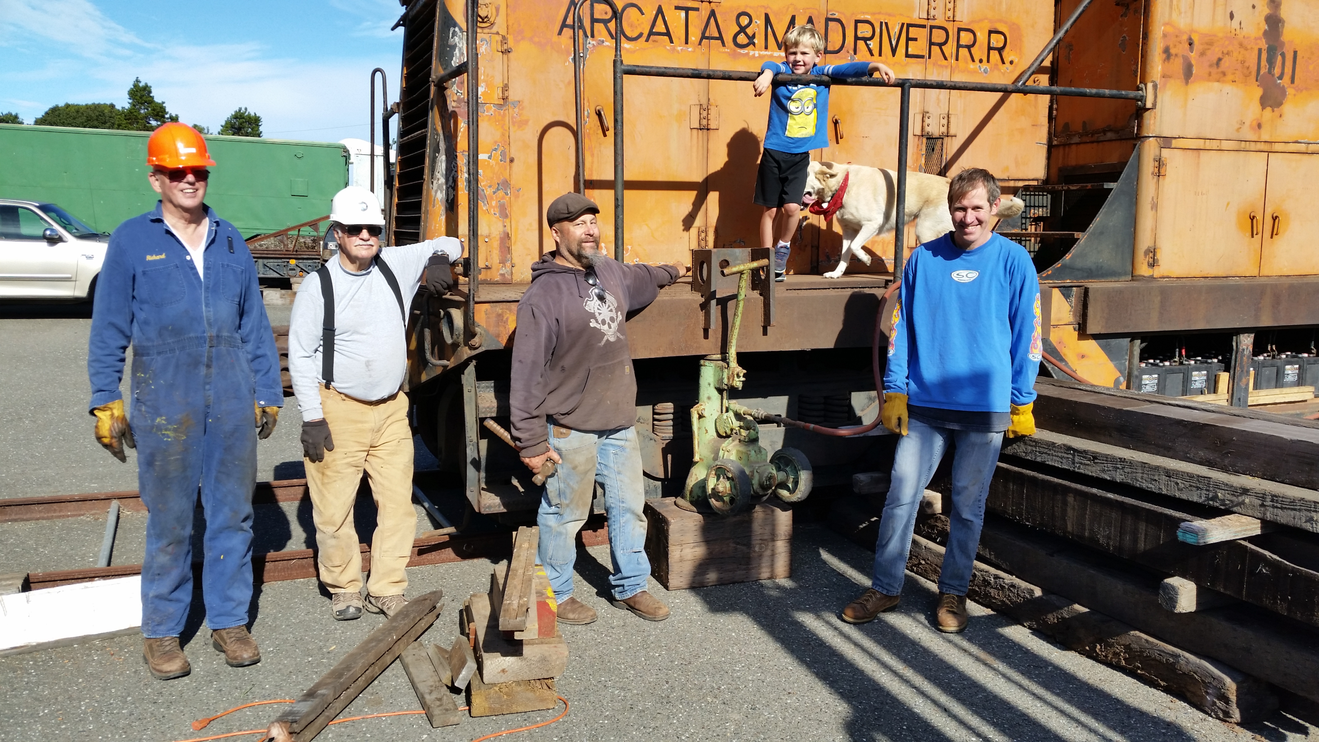
The Blind Leading the Blind: Removing a Truck

Slide 12
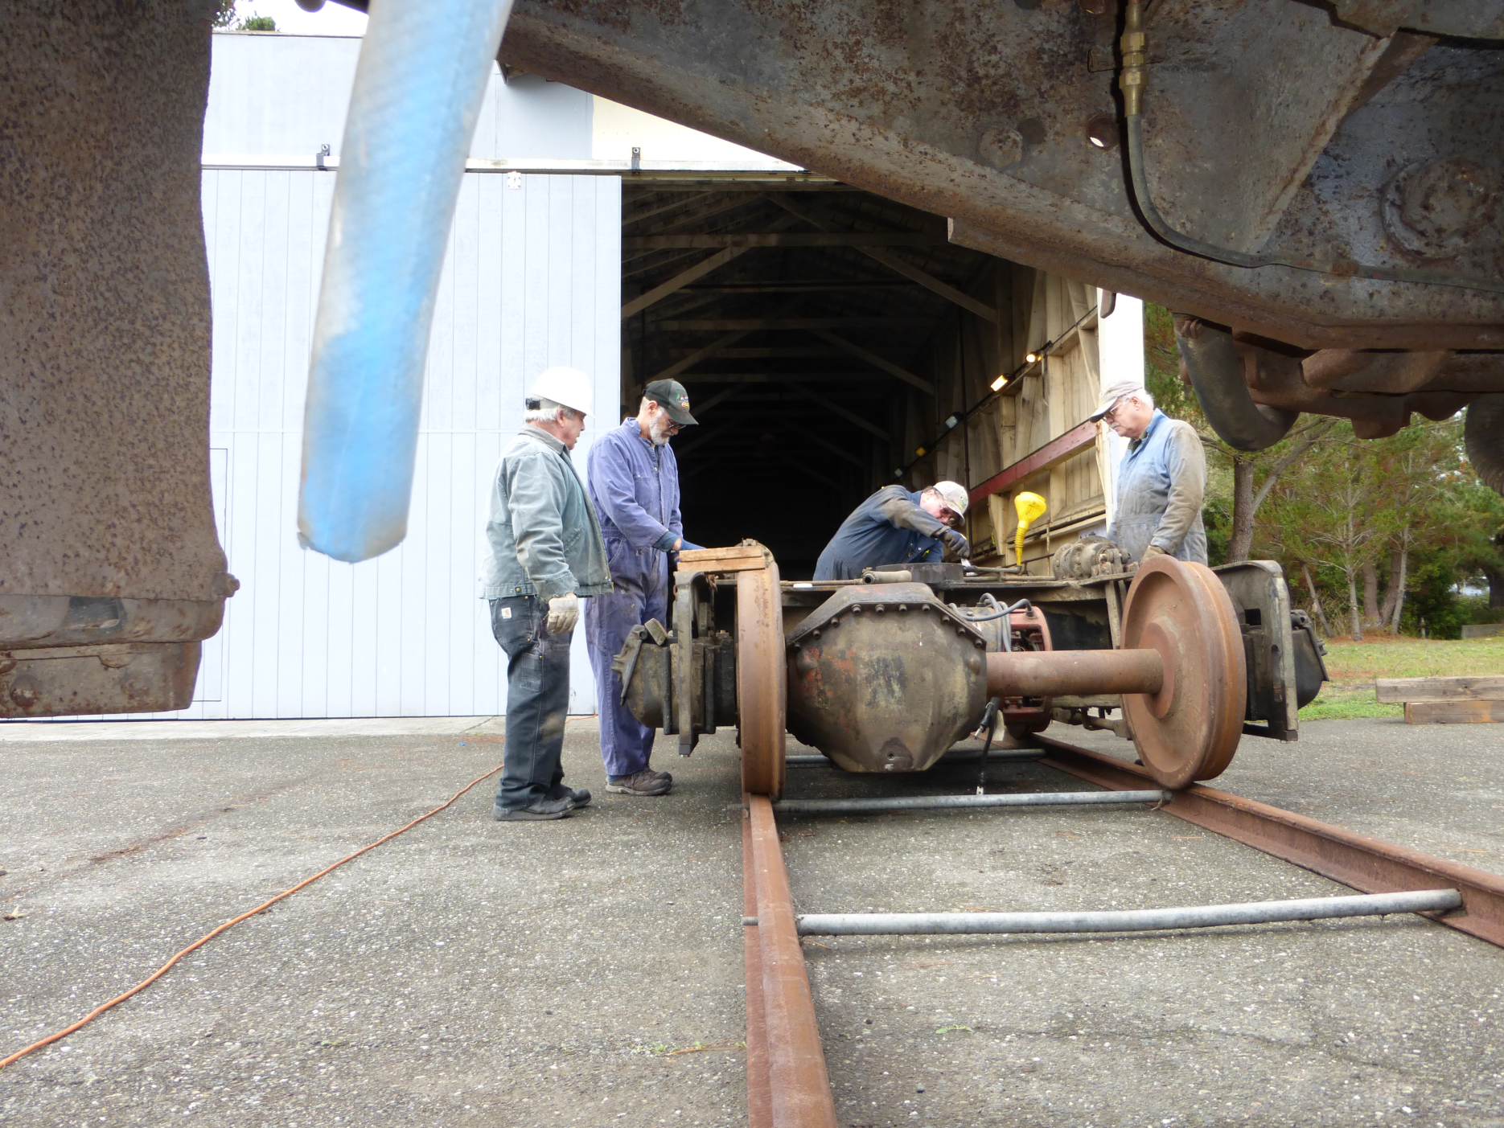
Out it Comes

Slide 13
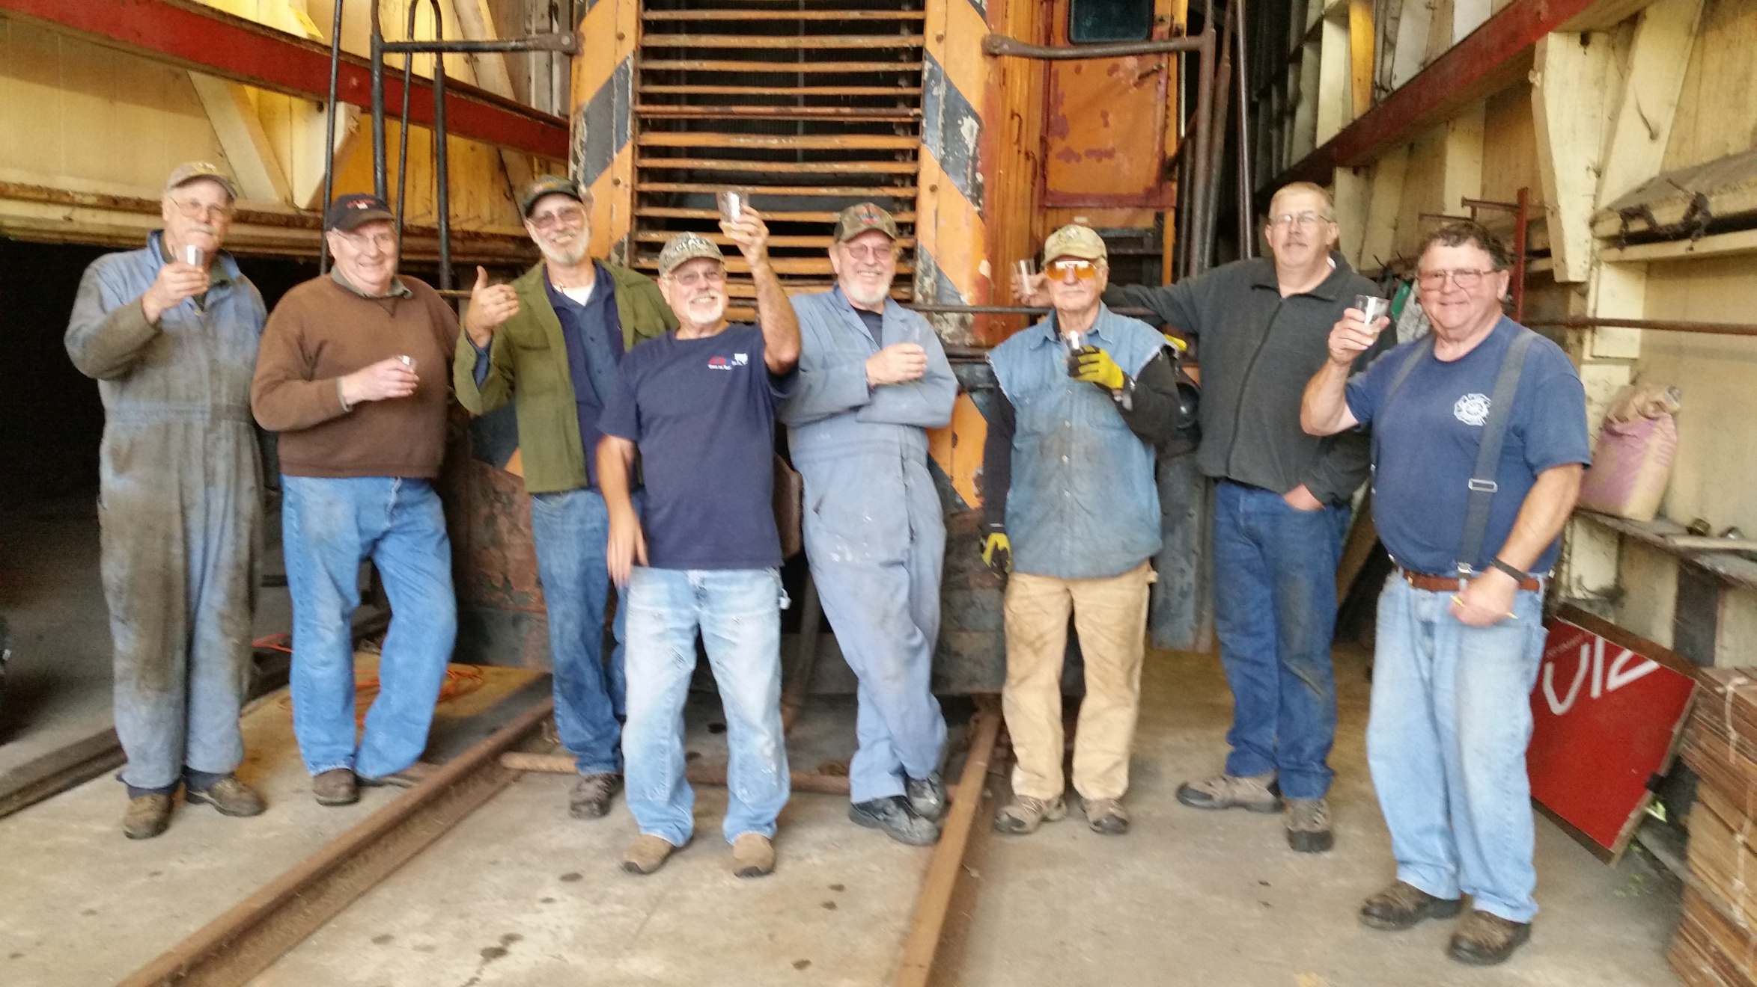
The Reward for a Job Well Done

Slide 14
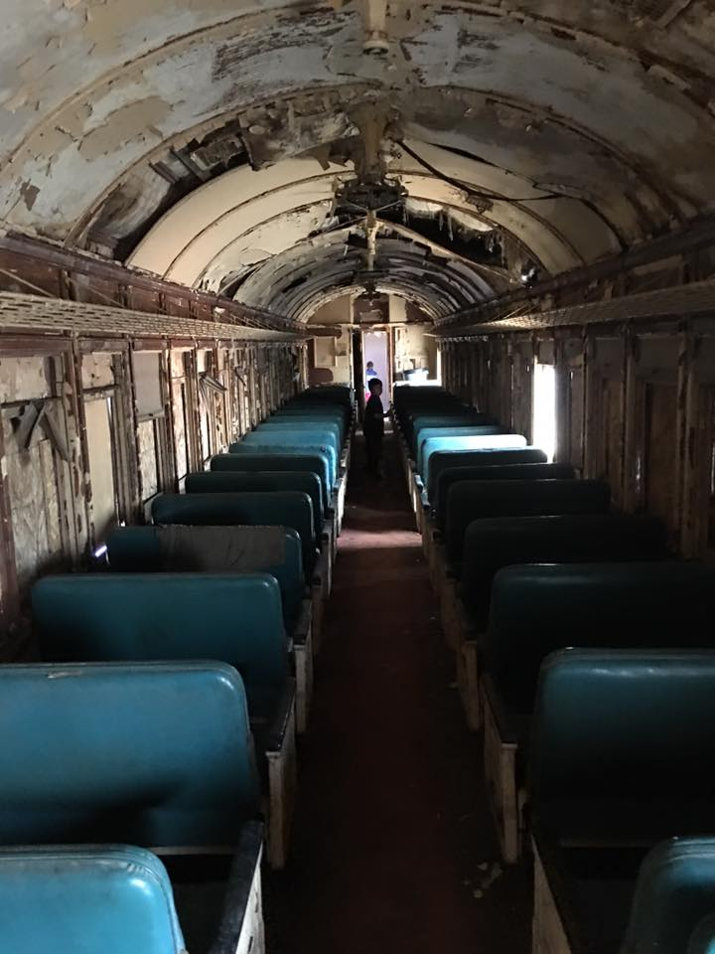
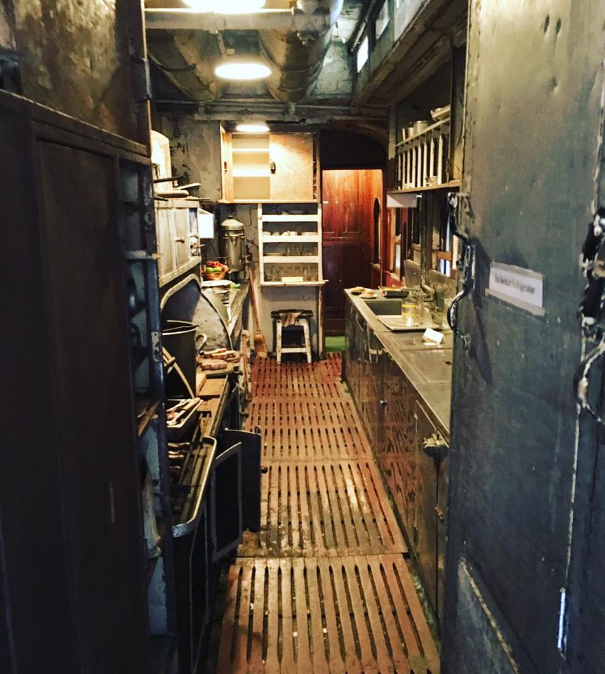
Next Up, Rail Car Restoration

Slide 15
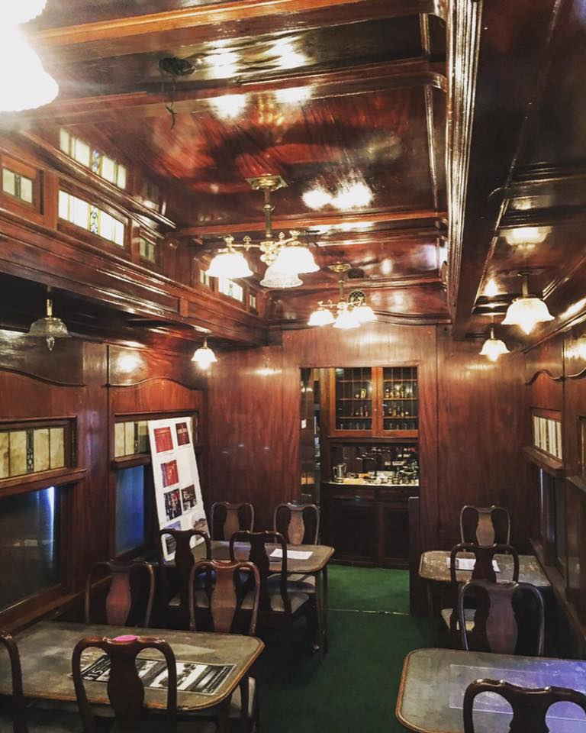
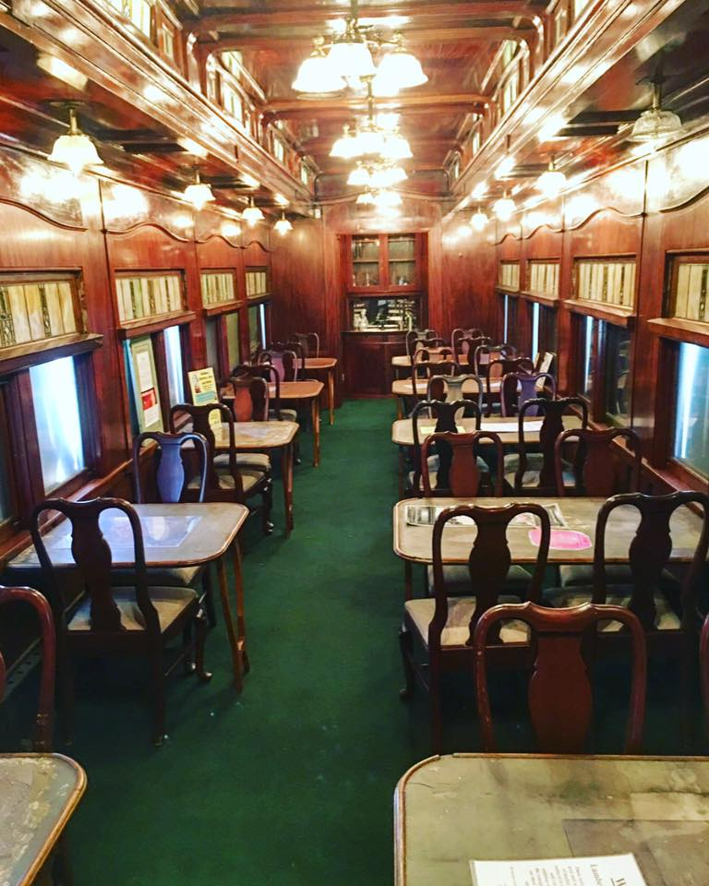
Dining Car Ready to Ride the Rails Again

Slide 16
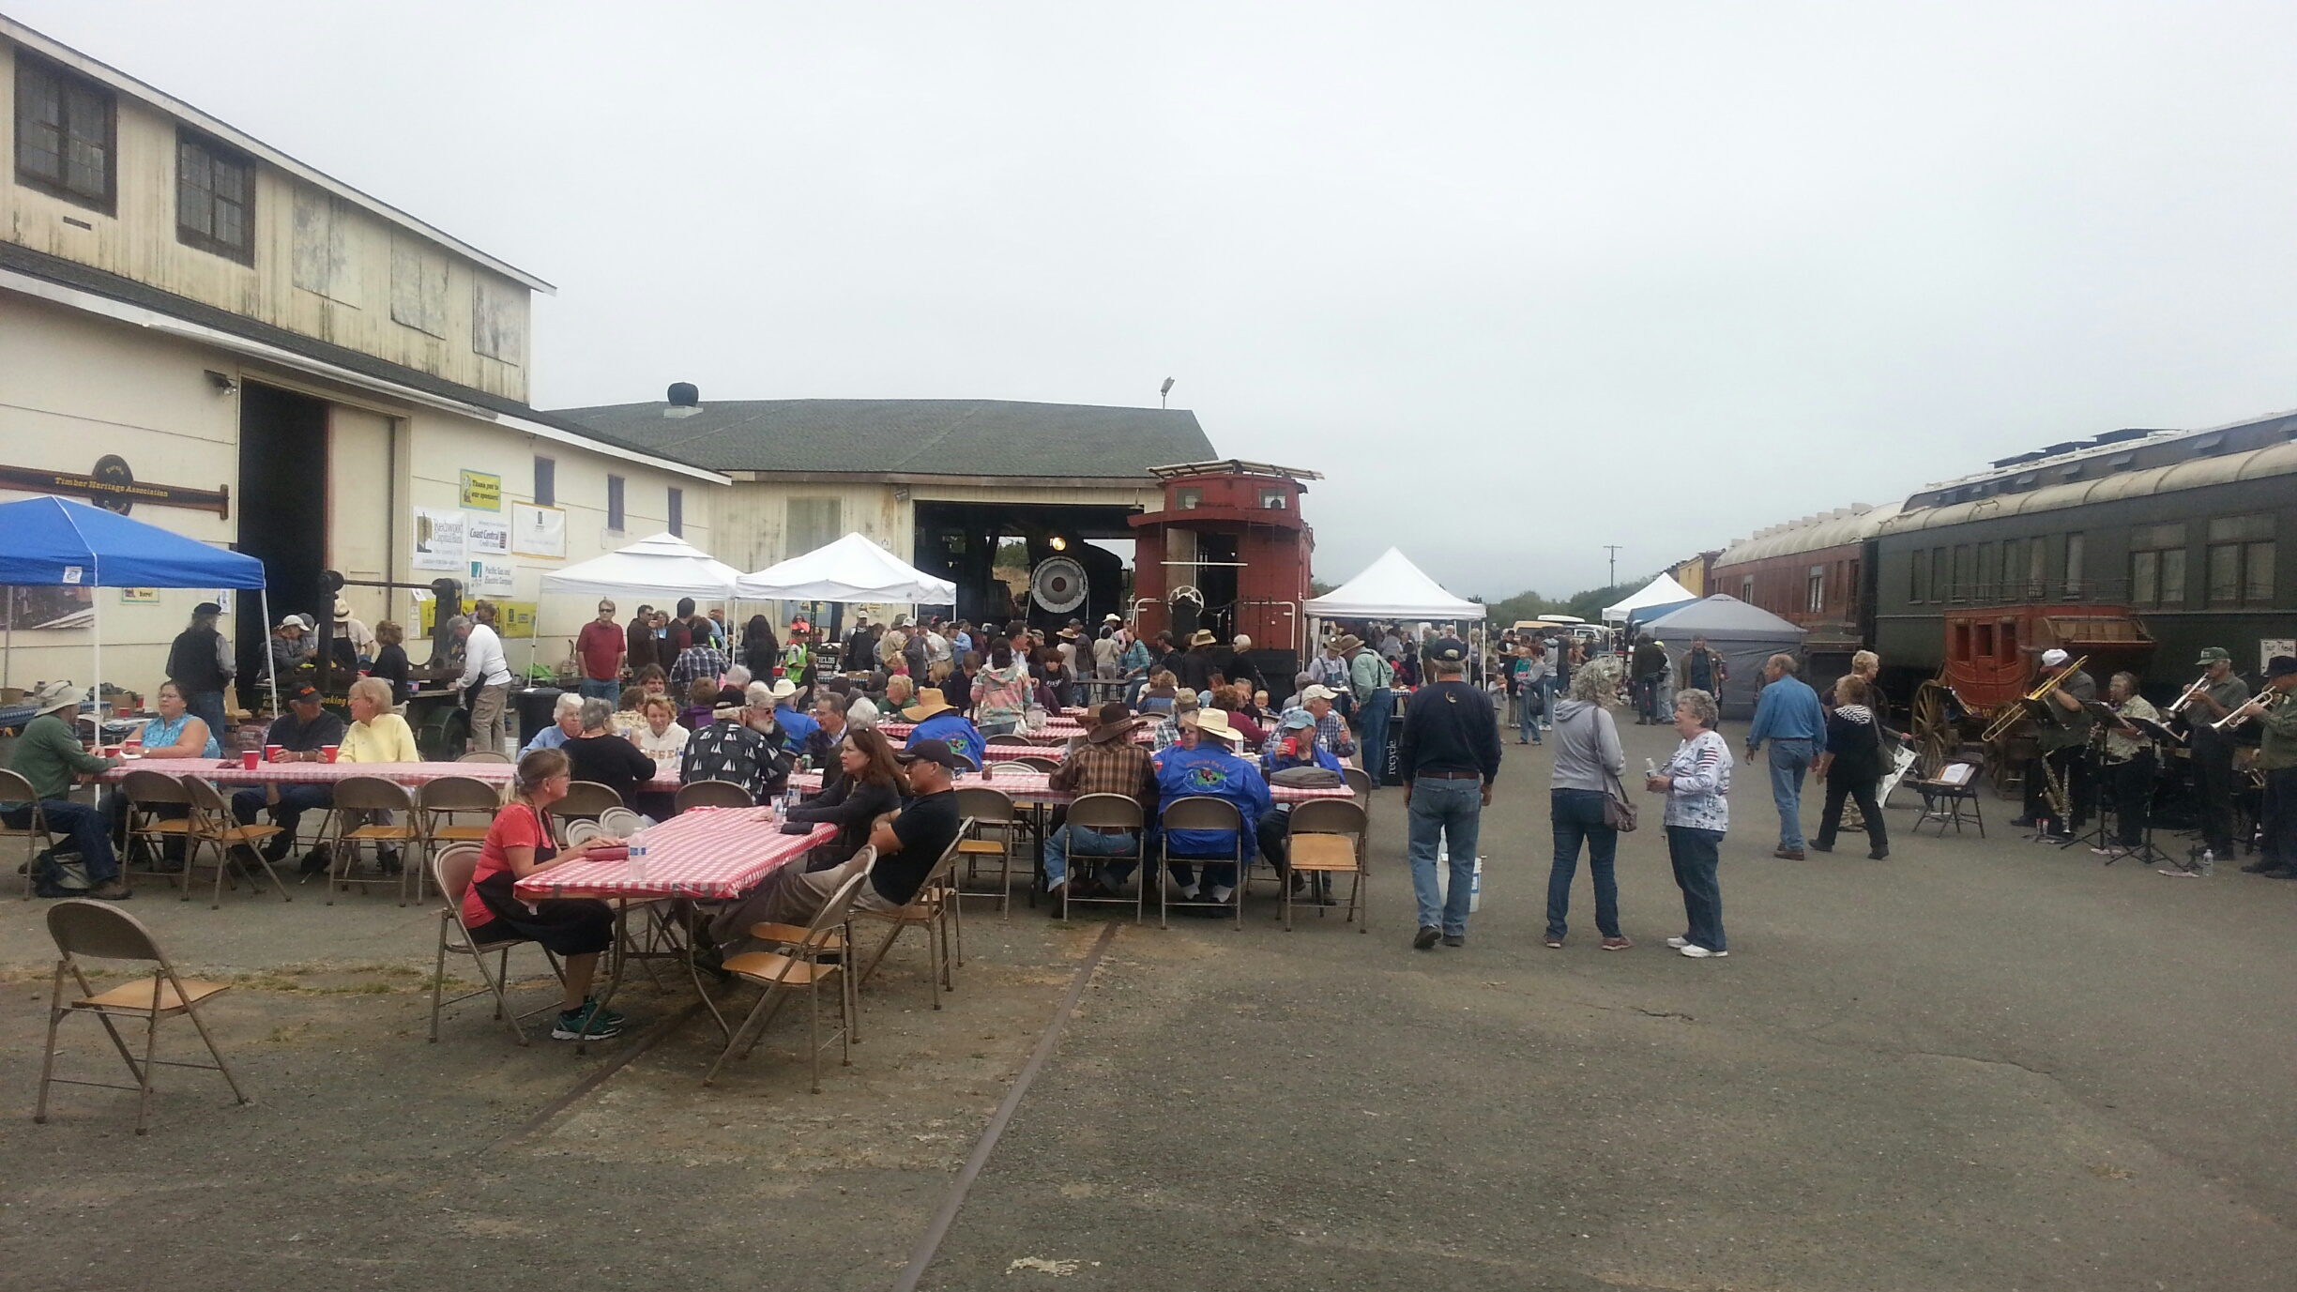
Obtaining the Funds via Fun Activities: SOAR

Slide 17
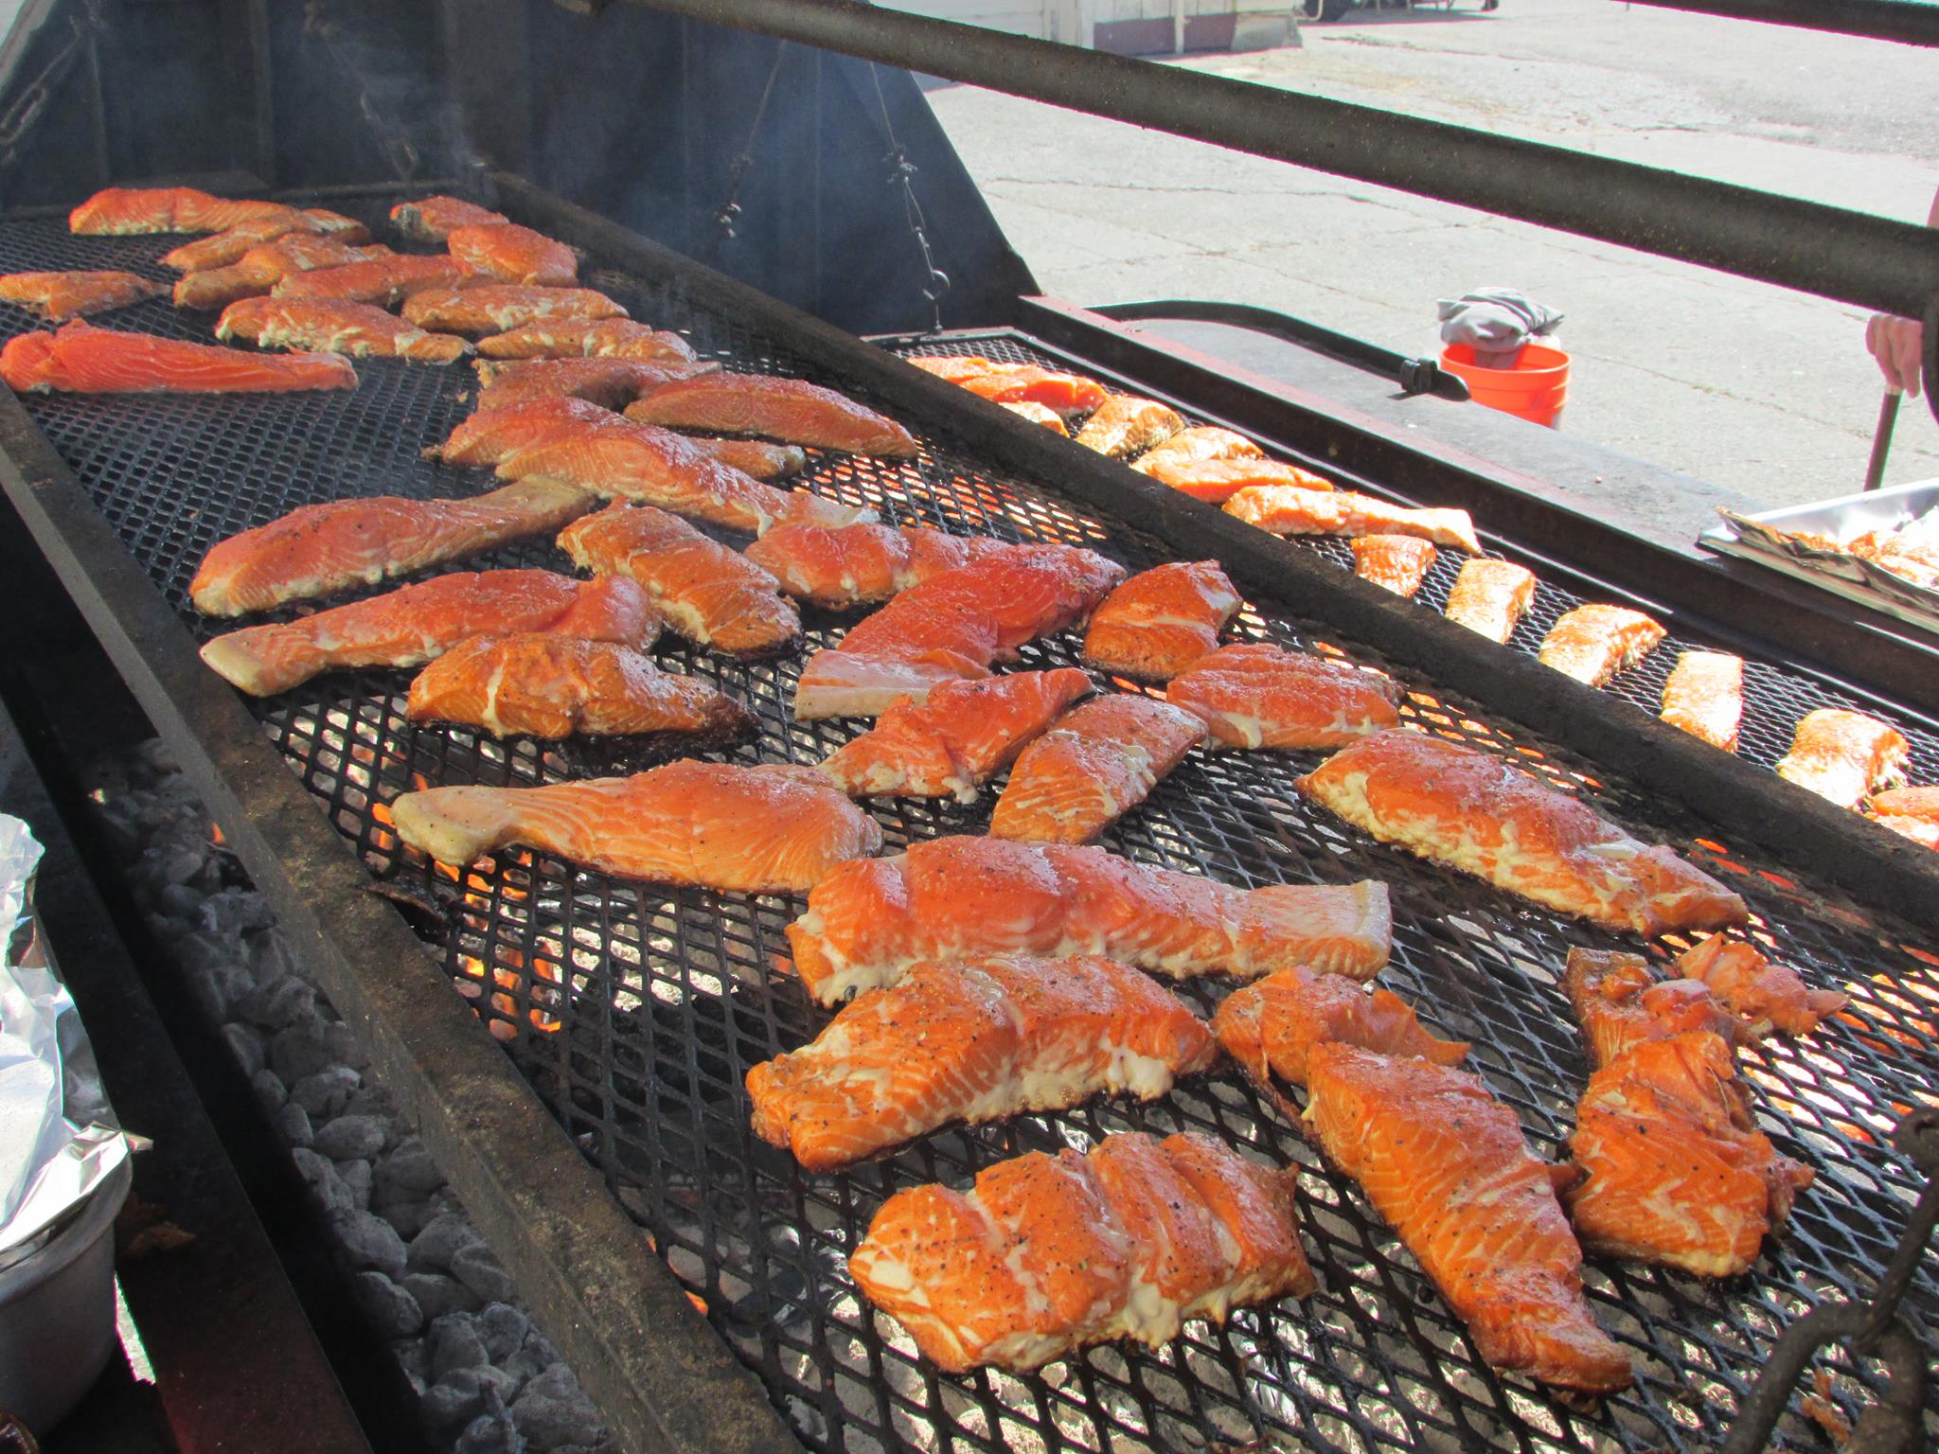
SOAR
S
A
L
M
O
N

Slide 18
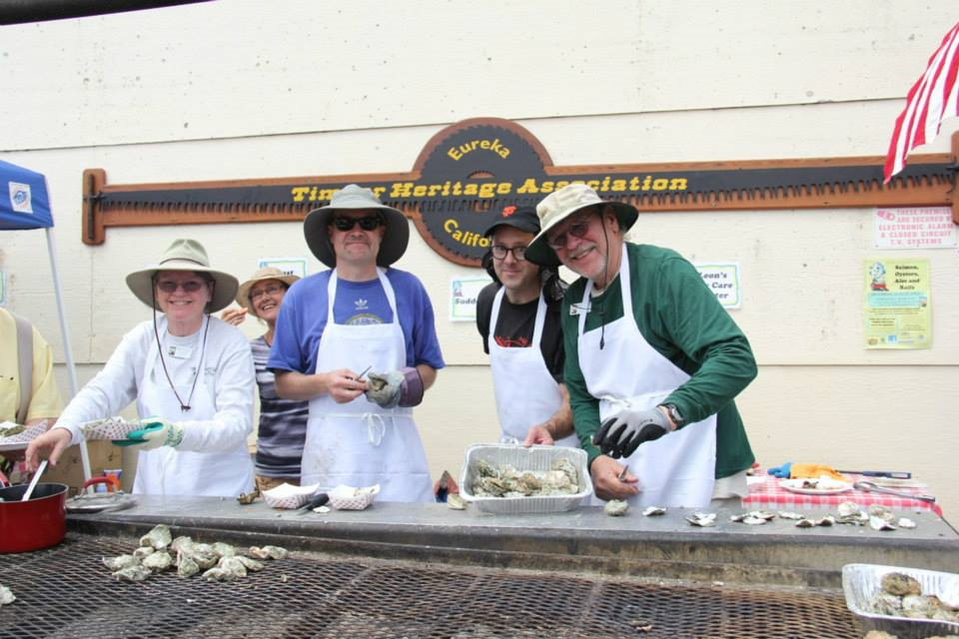
O
Y
S
T
E
R
S

Slide 19
ALES

Slide 20
AND RAIL

Slide 21
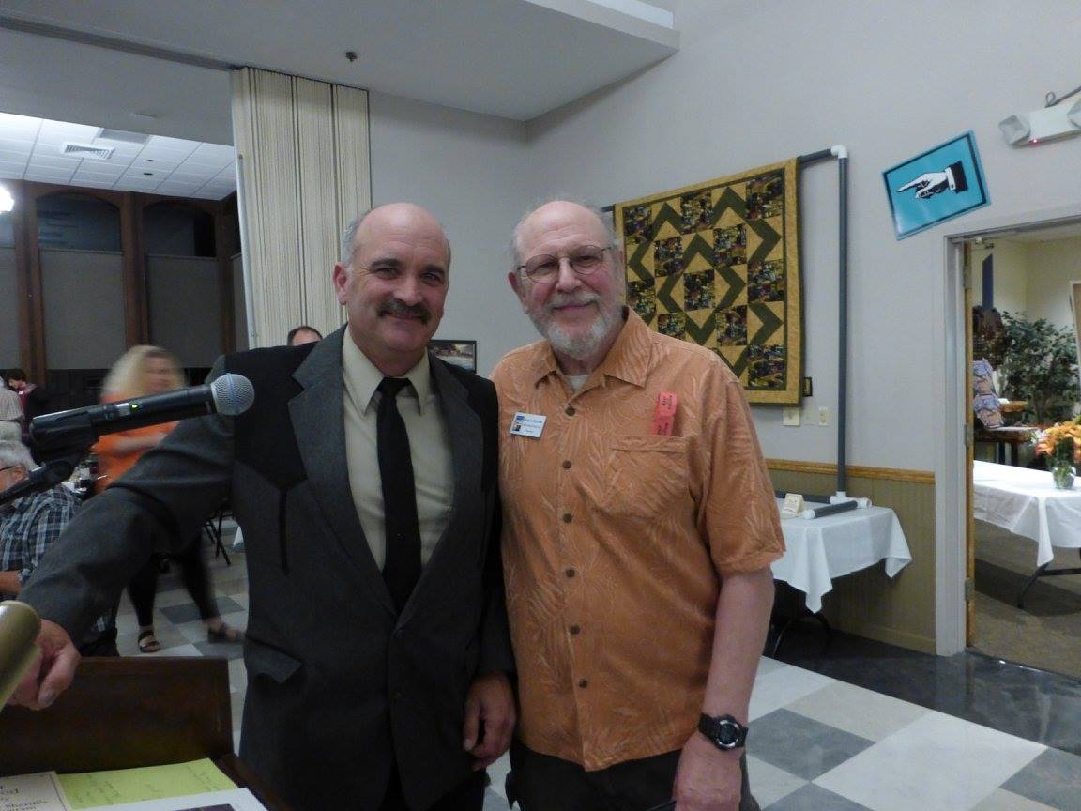
Roundhouse Rendezvous

Slide 22
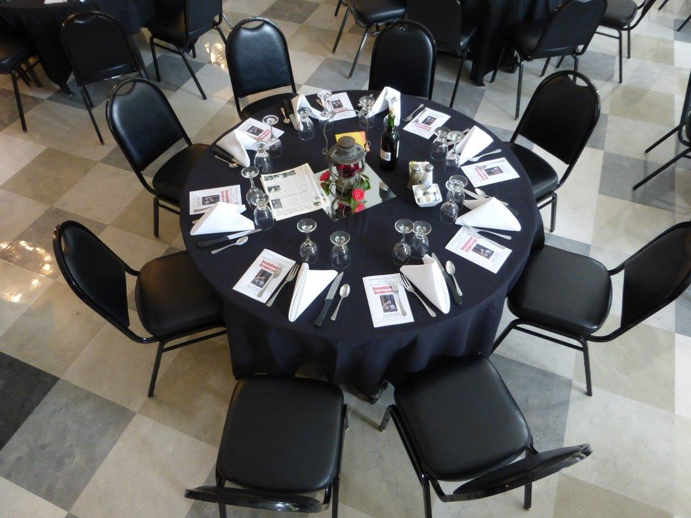
A Sit-down Dinner and Auction

Slide 23
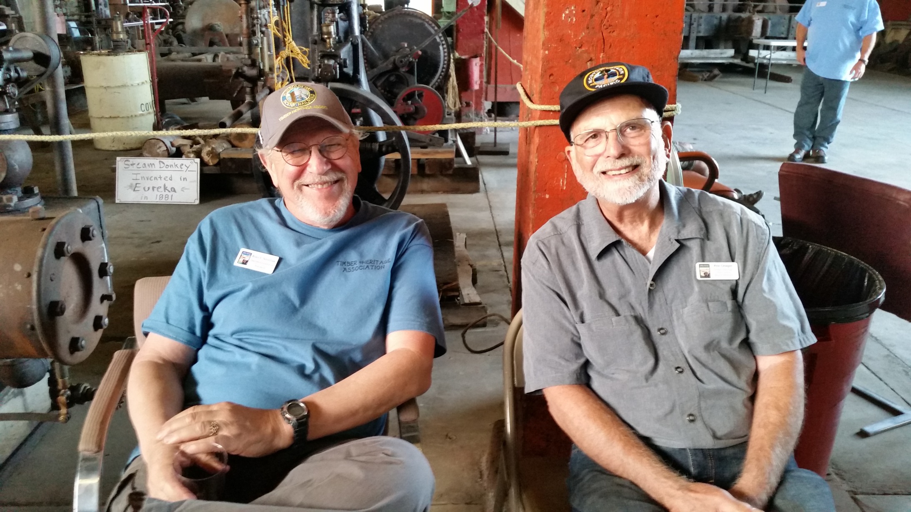
Hosting Chamber of Commerce Mixers

Slide 24
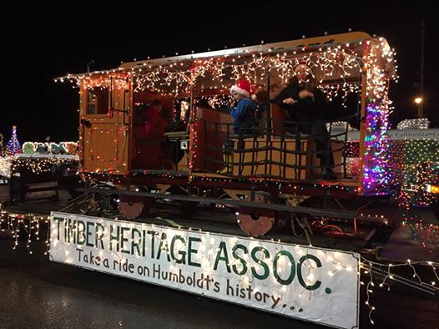
Community Outreach via the Annual Truckers Parade

Slide 25
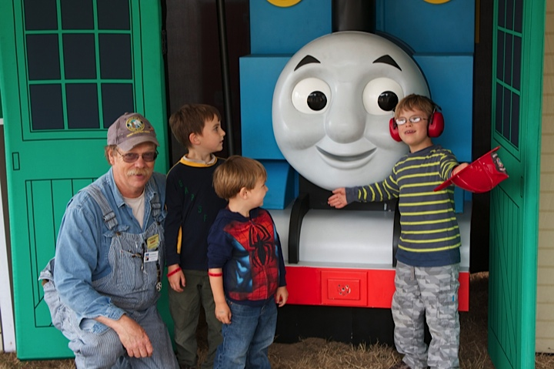
Sharing Tomas the Tank

Slide 26
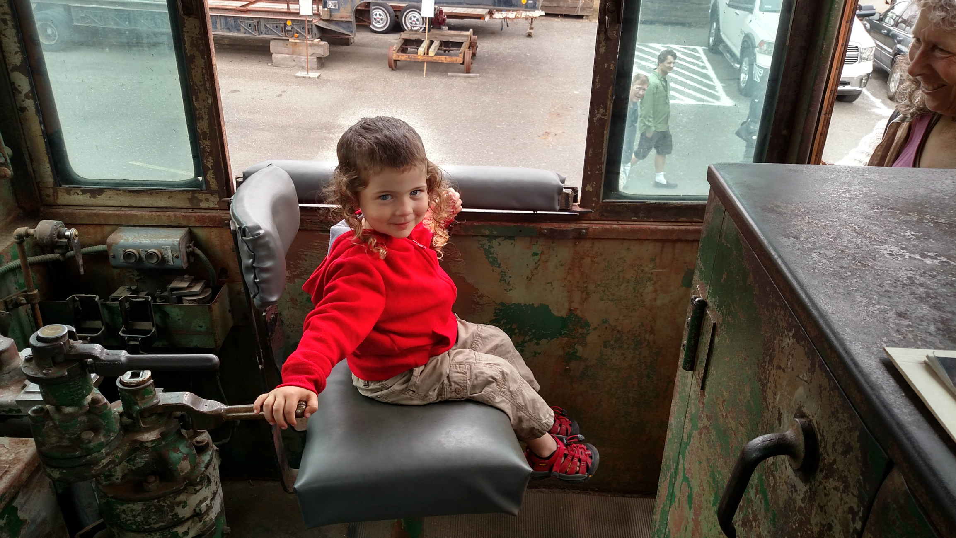
And Training the Next Generation of Volunteers

Slide 27
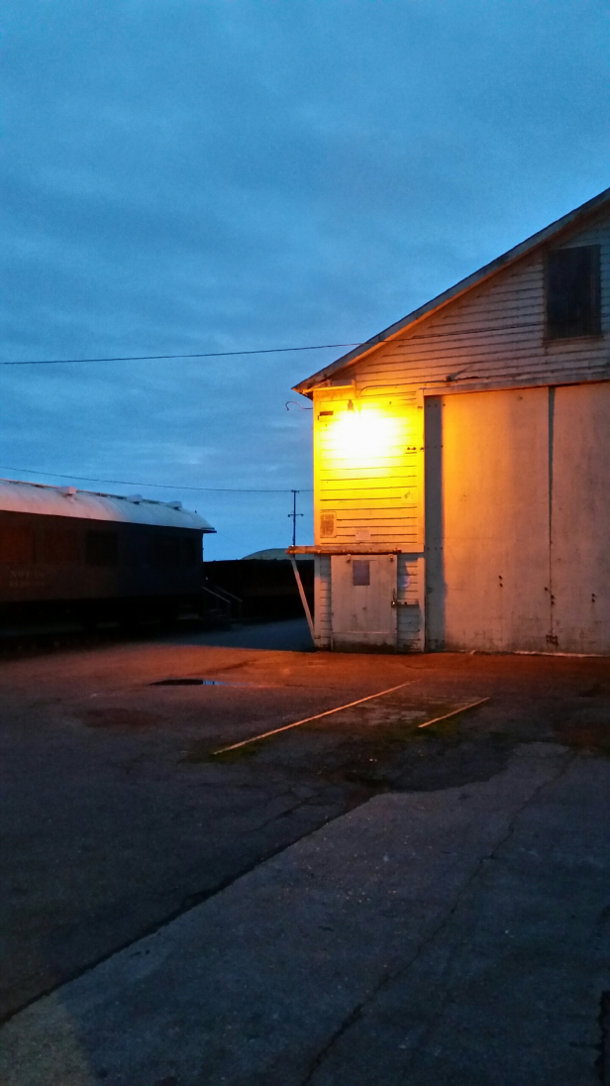
At the End of the Day, THA Is Doing Their Part to
Enhance the Visitors’ Experience and Improve
Humboldt Bay’s Economic Outlook

